Slide 1
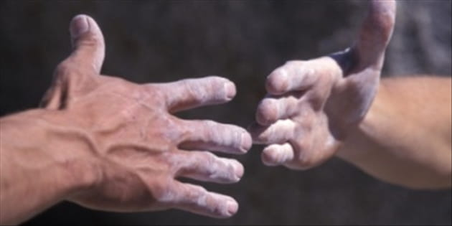
Be Giving
3 John
Dr. Rick Griffith • Crossroads International Church Singapore
BibleStudyDownloads.org

Slide 2

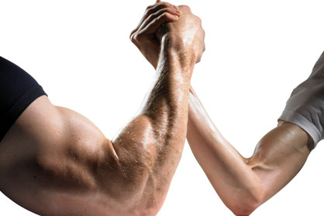
Ability or Integrity?
What is more important to you?
Notes:
A recent poll during an election year asked respondents what they considered more important in a presidential candidate: ability or integrity. Is it more important to have a candidate with expertise or high moral standards—for example, one who tells the truth? The results were sad as most preferred a candidate’s ability over his truthfulness. Obviously, both ability and integrity are needed in any job—especially the presidency! But how little attention is given to truth in today’s society! Anything goes!

Slide 3

"How can I hold my truth to be the truth when so many others see truth differently?"
Reporter in USA Weekend Report on Religion (1996)
Notes:
Do you see the subtle lie that “there is no objective truth”?

Slide 4
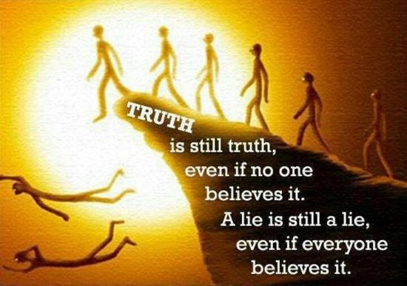
Truth is truth.
Truth is still truth
even if no one
believes it.
A lie is still a lie
even if everyone
believes it.
Notes:
Truth is truth, even if no one believes it. A lie is still a lie, even if everyone believes it. Gravity is true, so you WILL fall off the cliff even if you SINCERELY believe you won’t fall!

Slide 5
Courses I Teach
(English • Indonesian • Chinese)
Survey • The Bible…Basically
OT NT Bible Study
Backgrounds • Research & Writing
OT NT Geography
Theology • Creation • Jesus
Church • Spirit • Salvation • Future
Preaching
Homiletics 1 Homiletics 2
Notes:
I get to teach Asian leaders every book of the Bible in survey courses, plus backgrounds to both the OT and NT, three areas of theology, and how to preach.

Slide 6
27 NT Letters
28
19 respond to a heresy!
Notes:
Did you know that, of the 27 NT books, 19 of them responded to heresy afflicting the church? Talk about the need to know and obey God’s truth! Defending truth is a huge theme in the New Testament!

Slide 7

Do you need to obey God's truth?
Notes:
How many of you feel a need to obey God’s truth? Raise your hand if you feel the need to be obedient to the Bible.
Obviously there are numerous ways to obey God’s truth—prayer, reading the Bible, etc. but today we will focus on three ways noted in one of these 19 letters.

Slide 8
New Testament Overview
38
124
39-41
"To the remotest part of the earth" (Acts 1:8)
Acts 9 13 14 15 16 18 21 27 28
Apr 48-
Sep 49
1
Galatia
Apr 50-
Sep 52
2
Aegean
Spr 53-
May 57
3
Asia
Feb 60-
Mar 62
1
Rome
Spr 62-
Fall 67
4
Spain
Aut 67-
Spr 68
2
Rome
Summer 35-
37
Damascus
Antioch
May 57-
Aug 59
Trials
Fall 49
The
Council
Spring 68
Expansion of Church
35 48 49 50 52 53 57 60 62 67 68 95
Matt
Luke
Acts
Mark
John
Gal
1 Thess
1 Cor
Eph
1 Tim
2 Tim
Jude
James
2 Thess
2 Cor
Col
Titus
Heb
1 John
Romans
Philem
1 Pet
2 John
Gospels & Acts
Phil
2 Pet
3 John
Pauline Epistles
1234
Journeys
General Epistles
Rome
Imprisonments
General Epistles
Notes:
It was written near the end of the first century when an incredible amount of false teaching was afflicting the church—not unlike our time today.

Slide 9

Occasion
306
Before the NT writings were completed & circulated among the early believers, the churches relied upon traveling missionaries for truth.
Since inns were unsafe and few, these missionaries stayed with Christians.

Slide 10
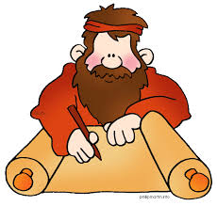
Occasion
306
A man named Gaius was faithfully extending hospitality to such men (vv. 5-8), despite opposition from a man in the church named Diotrephes (vv. 9-10).
John wrote to encourage Gaius to continue this practice of hospitality and support to missionaries.

Slide 11
Chapters in NT Books
Four "books" of the NT have but 1 chapter
Notes:
It doesn't seem right to call the four one-chapter writings "books" as they are so short!

Slide 12
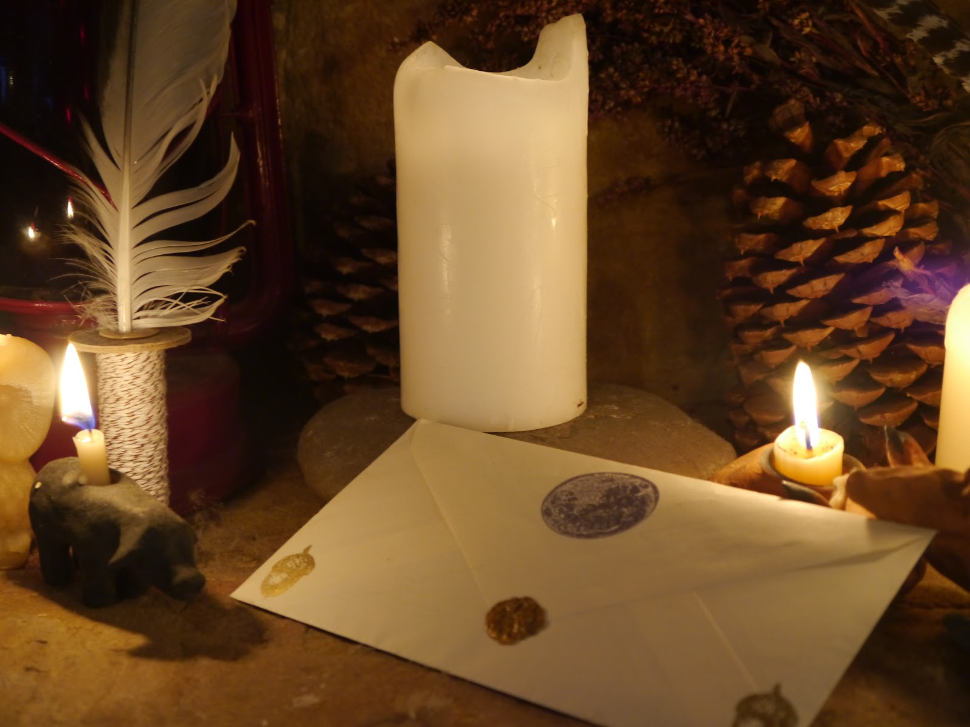
Verses in NT Emails
15
13
Words
245
219
Notes:
Each is about the length of an email, so I call them "NT Emails." The "E" is not for "electronic" but for "encouragement."

Slide 13
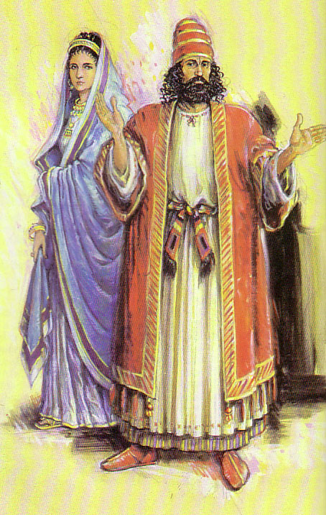
2 John versus 3 John
306
Contrasts
In 2 John the Apostle John warns against supporting false teachers
In 3 John he gives the "flip-side”: believers should support true missionary teachers.

Slide 14
2 John versus 3 John
306
Contrasts
 | 2 John | 3 John
Recipient | a Woman | a Man
Names | Anonymous | Gaius, Diotrephes, Demetrius
Mood | Condemns | Commends
Missionaries | False | True
Hospitality/Support | Misplaced | Missing (Diotrephes) Maintained (Gaius)
Verses | 13 | 15
Words (Greek text) | 245 | 219

Slide 15

Salutation (1-4 NLT)
306
This letter is from John, the elder. I am writing to Gaius, my dear friend, whom I love in the truth.
²Dear friend, I hope all is well with you and that you are as healthy in body as you are strong in spirit.
³Some of the traveling teachers recently returned and made me very happy by telling me about your faithfulness and that you are living according to the truth. ⁴I could have no greater joy than to hear that my children are following the truth.
Notes:
Did you notice the emphasis on truth in verses 1-4?

Slide 16

How can we obey God's truth?
3 ways…
Notes:
What ways can we follow what the Lord says? There exist thousands of ways to obey him, but this "email" gives three ways to support the facts of the NT.

Slide 17
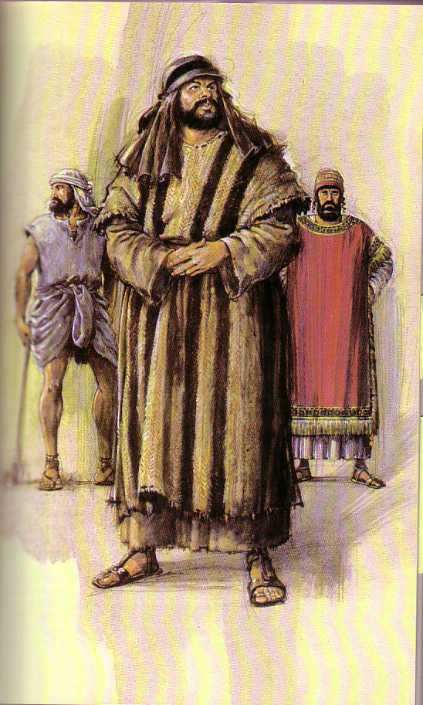
This warm, personable letter revolves around 3 men:
306
Diotrephes is a carnal believer opposing hospitality towards the missionaries practiced by Gaius and other believers
(9-11)
Demetrius is a missionary whom the church should support
(12)
Gaius is a godly man who wholeheartedly supports the missionaries (1-8)
Notes:
The three ways to obey God's truth revolve around the three men in this short epistle.

Slide 18
How can we obey God’s truth?
306
I. Help others get the truth out like Gaius (5-8)
Notes:
Follow the example of the godly man Gaius by supporting God’s workers.

Slide 19
Gaius
306
"Dear friend, you are being faithful to God when you care for the traveling teachers who pass through, even though they are strangers to you. ⁶They have told the church here of your loving friendship."
"Please continue providing for such teachers in a manner that pleases God. ⁷For they are traveling for the Lord, and they accept nothing from people who are not believers."
Notes:
We all show hospitality to people we know––like relatives (or at least we should).
But Gaius supported them even though he didn’t know them personally when they showed up at his church. They just had to be workers for the truth and he would help them out.
Verse 6 says Gaius sent them out in a “manner worthy of God.” What does that mean?
Verse 7 provides a partial answer: Gaius gave them “help” since non-Christians don’t support missionaries.

Slide 20
Keys to the Postcard
305
Key Word: Missionaries
Key Verse:
"We ought therefore to show hospitality to such men [missionaries] so that we may work together for the truth"
(3 John 8 NIV)
Notes:
But how does helping get the truth out apply to you and me?
We also aid the truth by supporting and housing missionaries.

Slide 21

Will you pray?
Notes:
The absolutely best way to support your missionaries is through prayer. This weekend begins the 30 days of prayer for the followers of Islam, who desperately need the gospel. Pick up a prayer guide and join the many doing this for the next month.

Slide 22

Our Mission Organization…
Notes:
Supporting truth is just what this church is doing with us. We came from the USA with WorldVenture in 1991 as representatives of the truth of God…

Slide 23
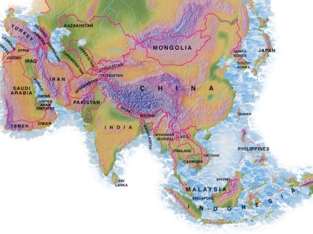

Singapore Bible College Students
USA
MONGOLIA
JAPAN
KOREA
CHINA
NEPAL
HONG KONG
MYANMAR
INDIA
THAILAND
VIETNAM
PHILIPPINES
MALAYSIA
SINGAPORE
SBC
INDONESIA
Notes:
… in Singapore, teaching His truth to leaders from 25 nations at Singapore Bible College—and this church has, like Gaius, faithfully supported us for many years.

Slide 24
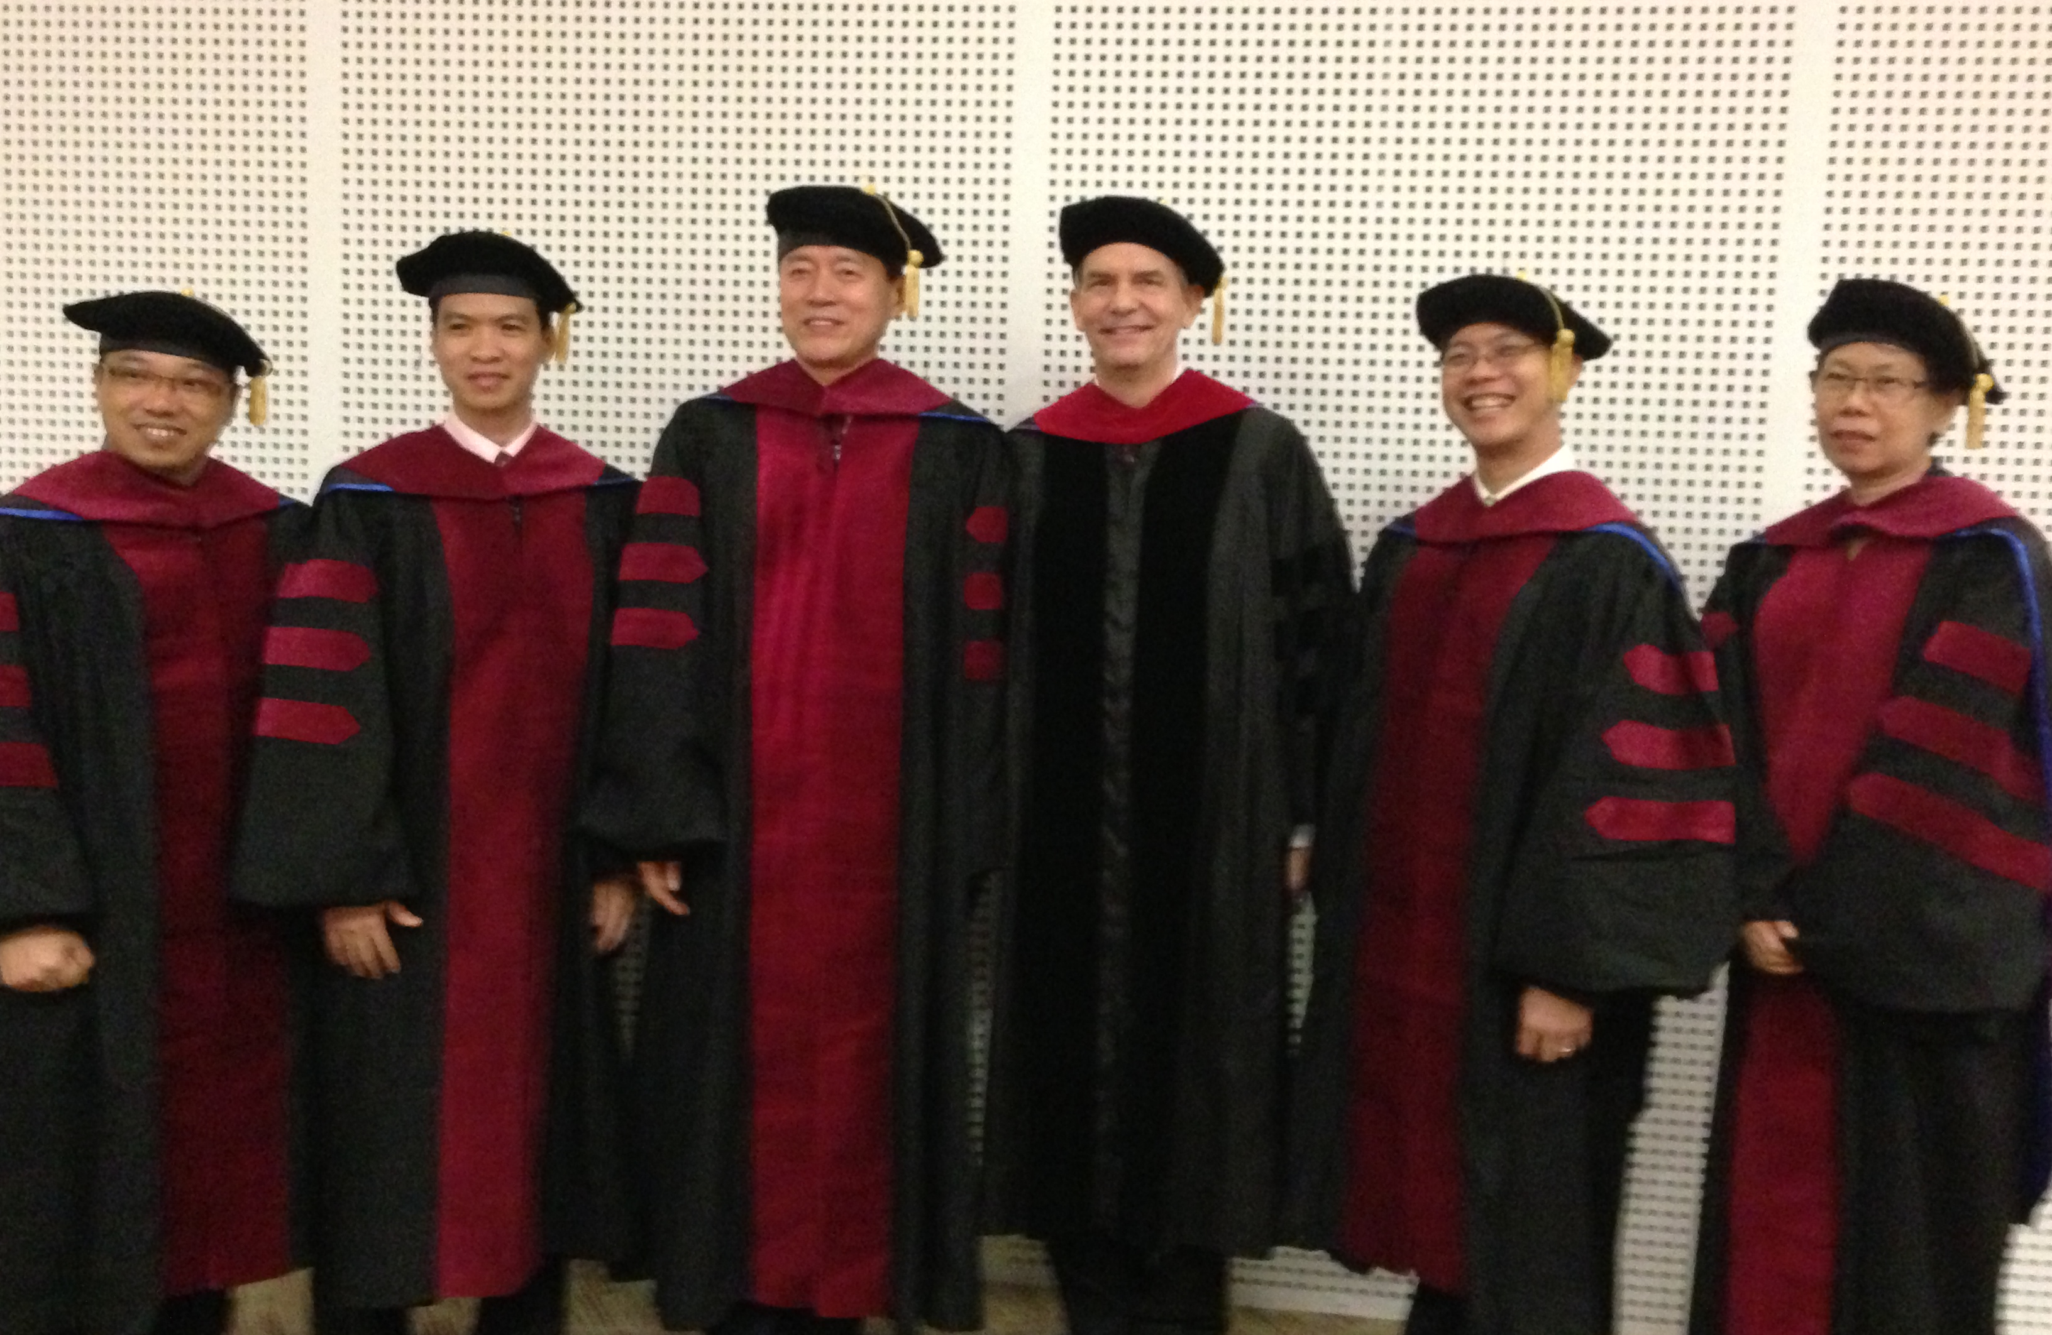
I direct the SBC Doctor of Ministry studies (DMin)
9
Notes:
I'm also the director of the doctoral program at SBC that trains about 70 seminary professors and pastors throughout Asia in English and Chinese. Generally each year about 5 of them received their Doctor of Ministry degree.

Slide 25
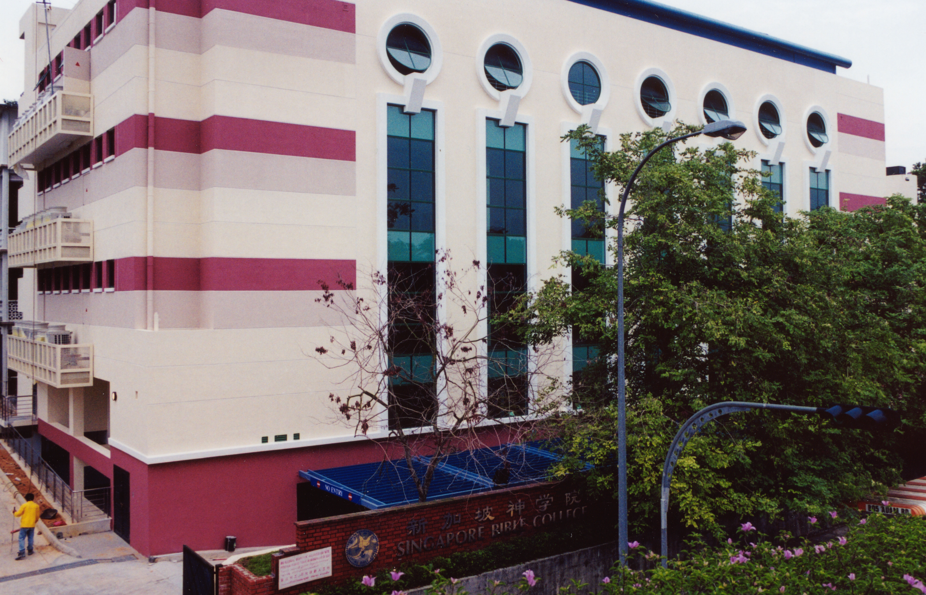
SINGAPORE BIBLE COLLEGE
9
Notes:
I've served as a seminary professor with 30 other faculty at Singapore's largest training school: Singapore Bible College

Slide 26
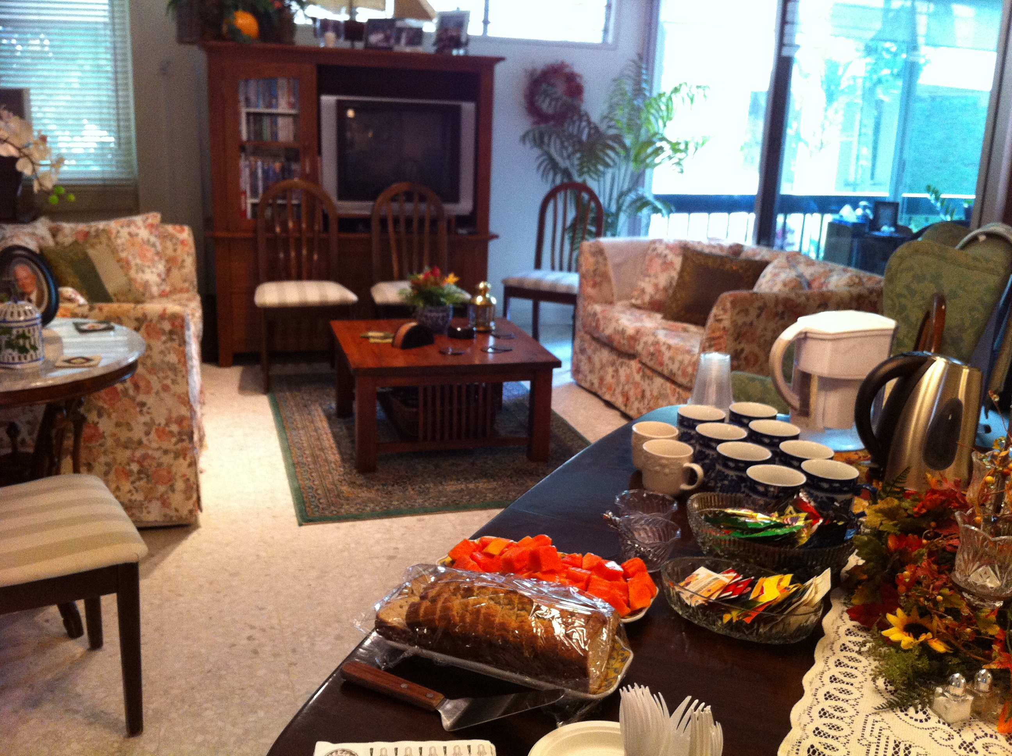
Our Singapore Bible College Apt.
9
Notes:
Our Wednesday pattern to set up the table for our Pastoral Care Group that comes up to our apartment on campus.

Slide 27
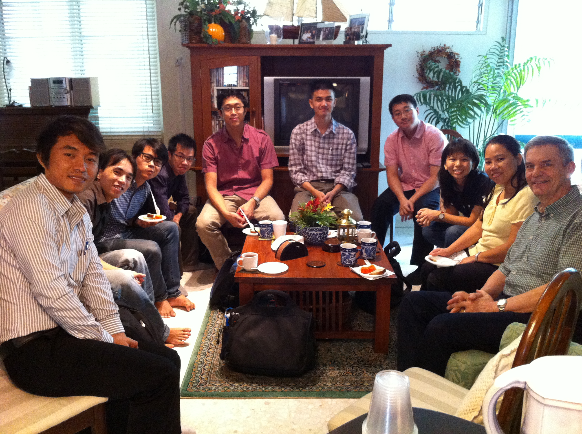
Singapore Bible College Students
9
Notes:
Our Pastoral Care Group has 9 students from Myanmar, Vietnam, Singapore, and Hong Kong.

Slide 28
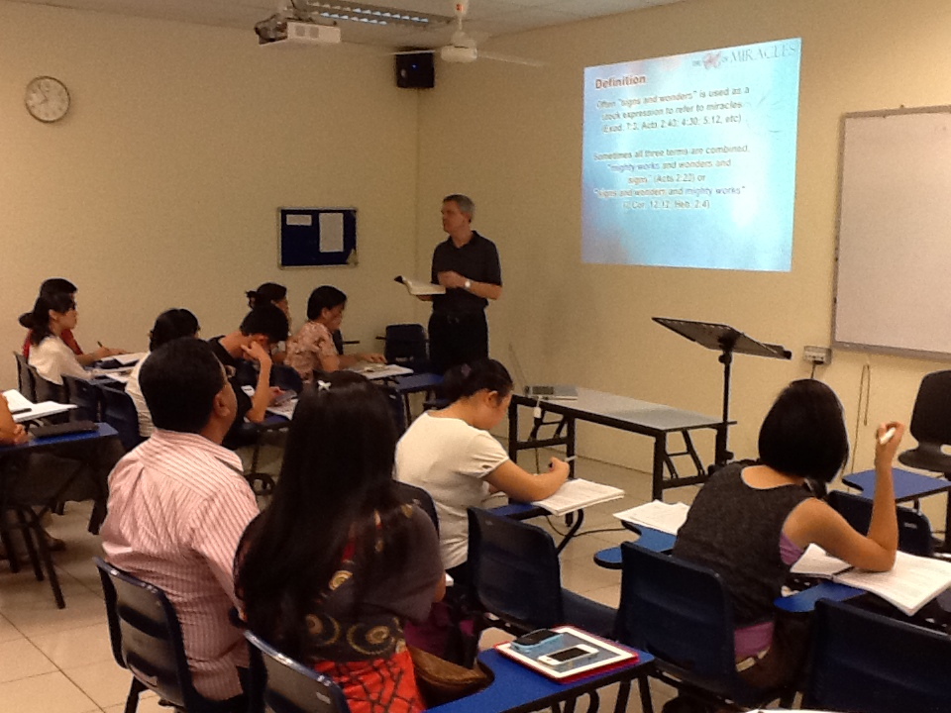
Singapore Bible College Students
Notes:
Thank you for spreading the truth by helping me teach leaders truth…

Slide 29


NT Survey link at BibleStudyDownloads.org
Get this presentation for free!
Notes:
Student translation since 2003 with 700 translators has resulted in Bible teaching and study materials—mostly PowerPoint—in 49 languages! All a teacher needs to do is to click on a file and it downloads for free to teach any book of the Bible and many other subjects.
NT Survey (ns)

Slide 30

BibleStudyDownloads.org
7
Notes:
Currently we have 33 courses on the website.

Slide 31
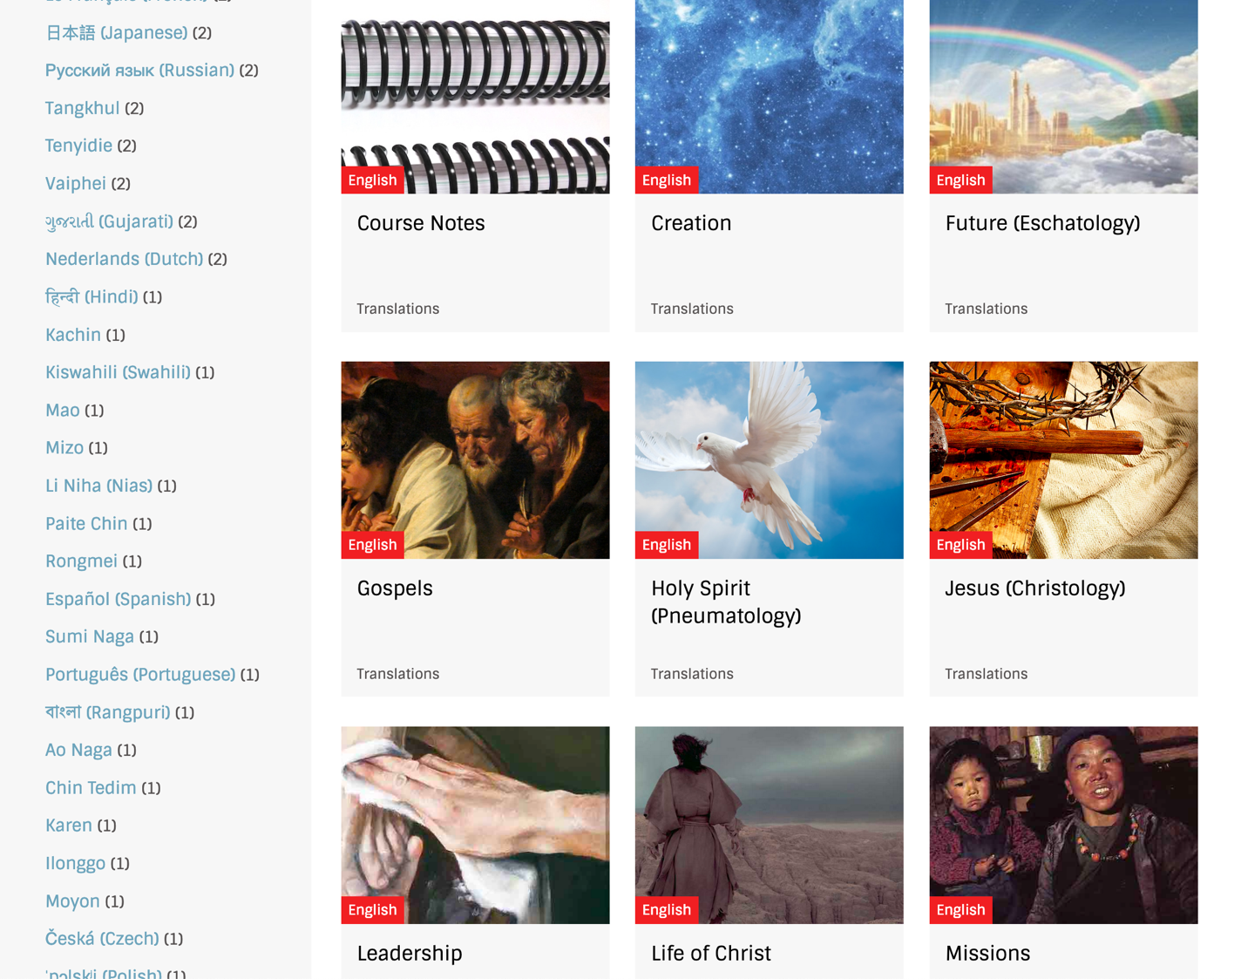
BibleStudyDownloads.org
7
Notes:
These include Bible, theology, church history, and practical ministry

Slide 32
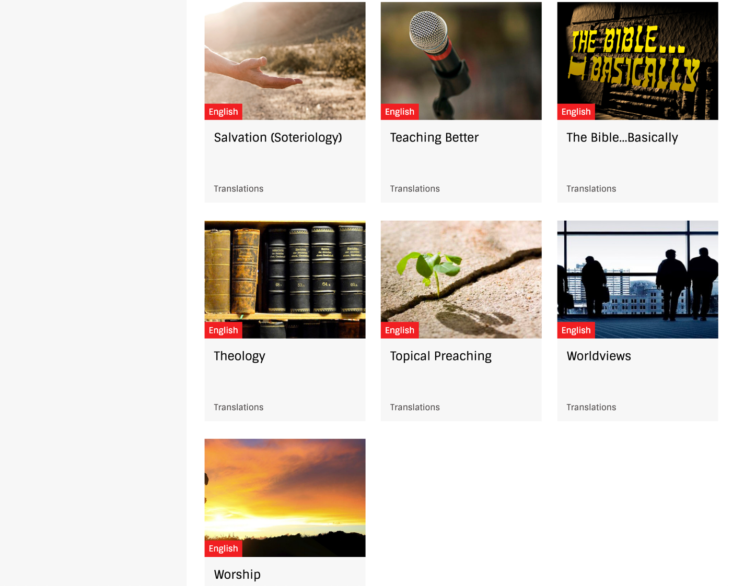
BibleStudyDownloads.org
7
Notes:
Most of these courses are mine, but others have also shared their courses with me.

Slide 33
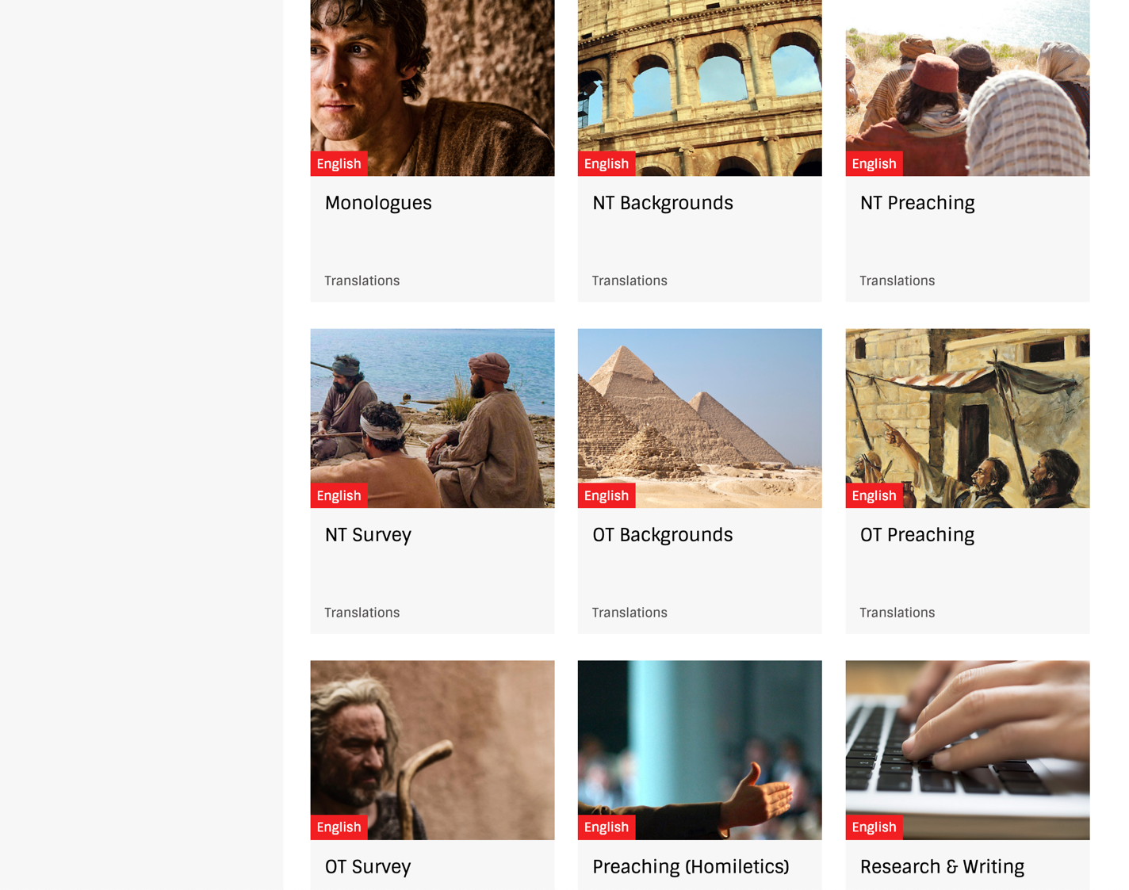
BibleStudyDownloads.org
7
Notes:
So all you need to do is to click on a course as there are no passwords. For example, select New Testament Survey to get NT materials.

Slide 34
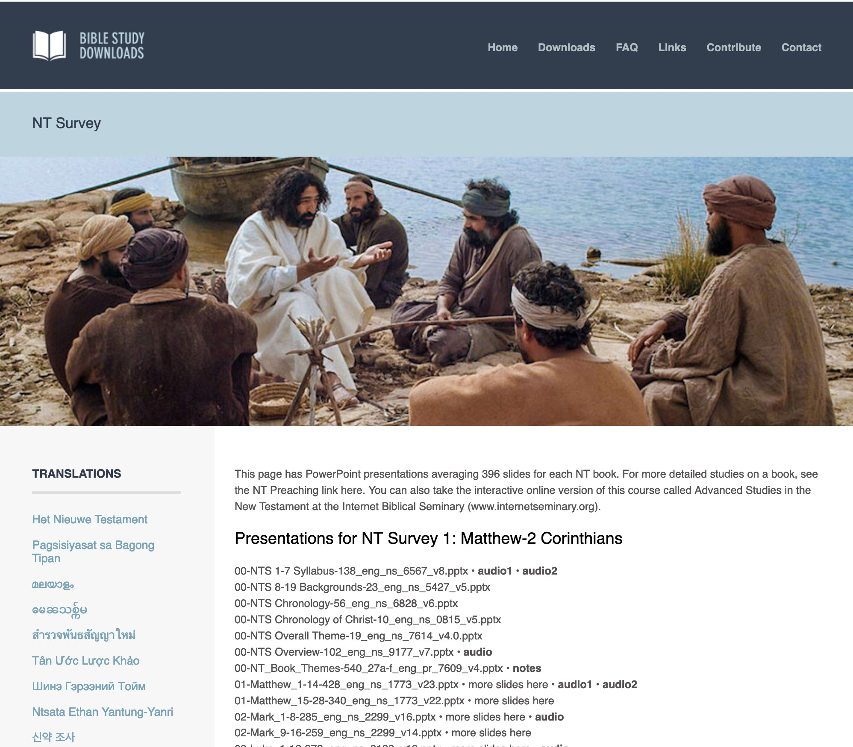
BibleStudyDownloads.org
7
English
Notes:
This brings you to the English page where some of the 66,000 PPT slides in English are accessed.

Slide 35
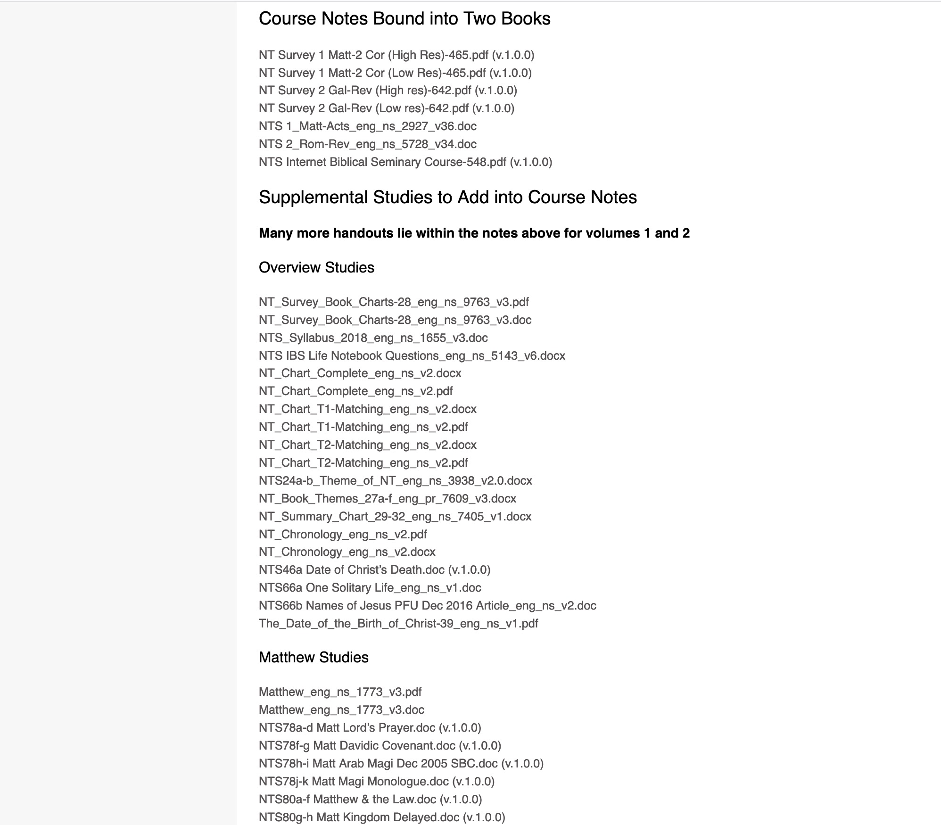
BibleStudyDownloads.org
7
NT Survey
Class Notes
Notes:
About 20,000 pages of notes are also available for free download.

Slide 36
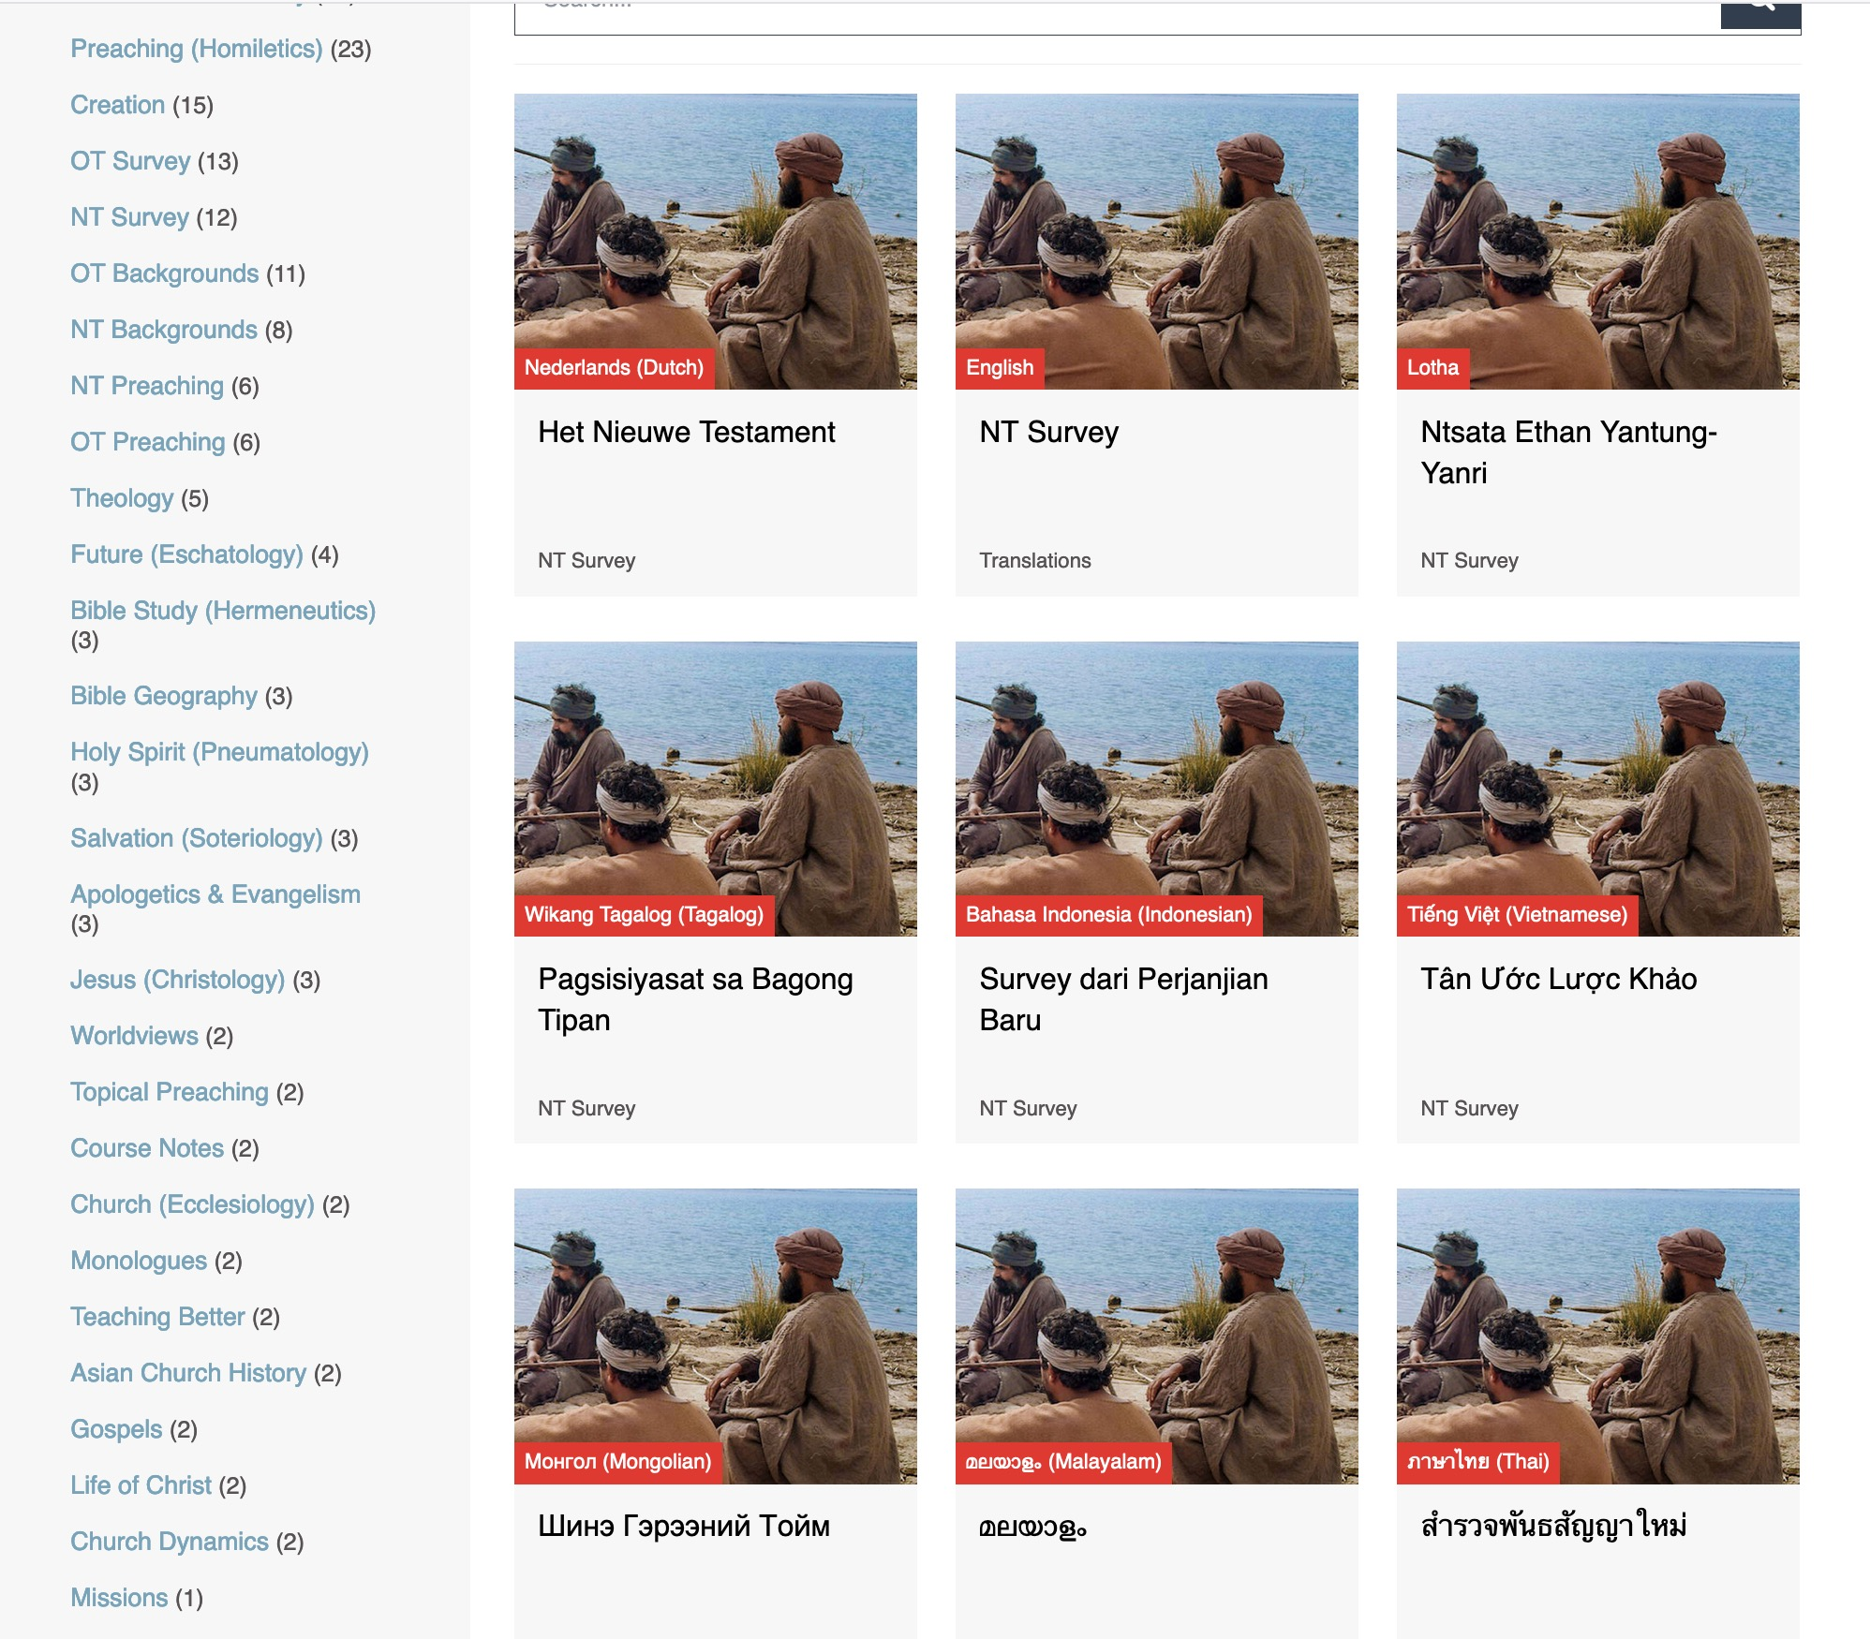
BibleStudyDownloads.org
7
Translations
Notes:
ON the left column are the present translations of each course. Here are 9 languages featured for NT Survey.

Slide 37
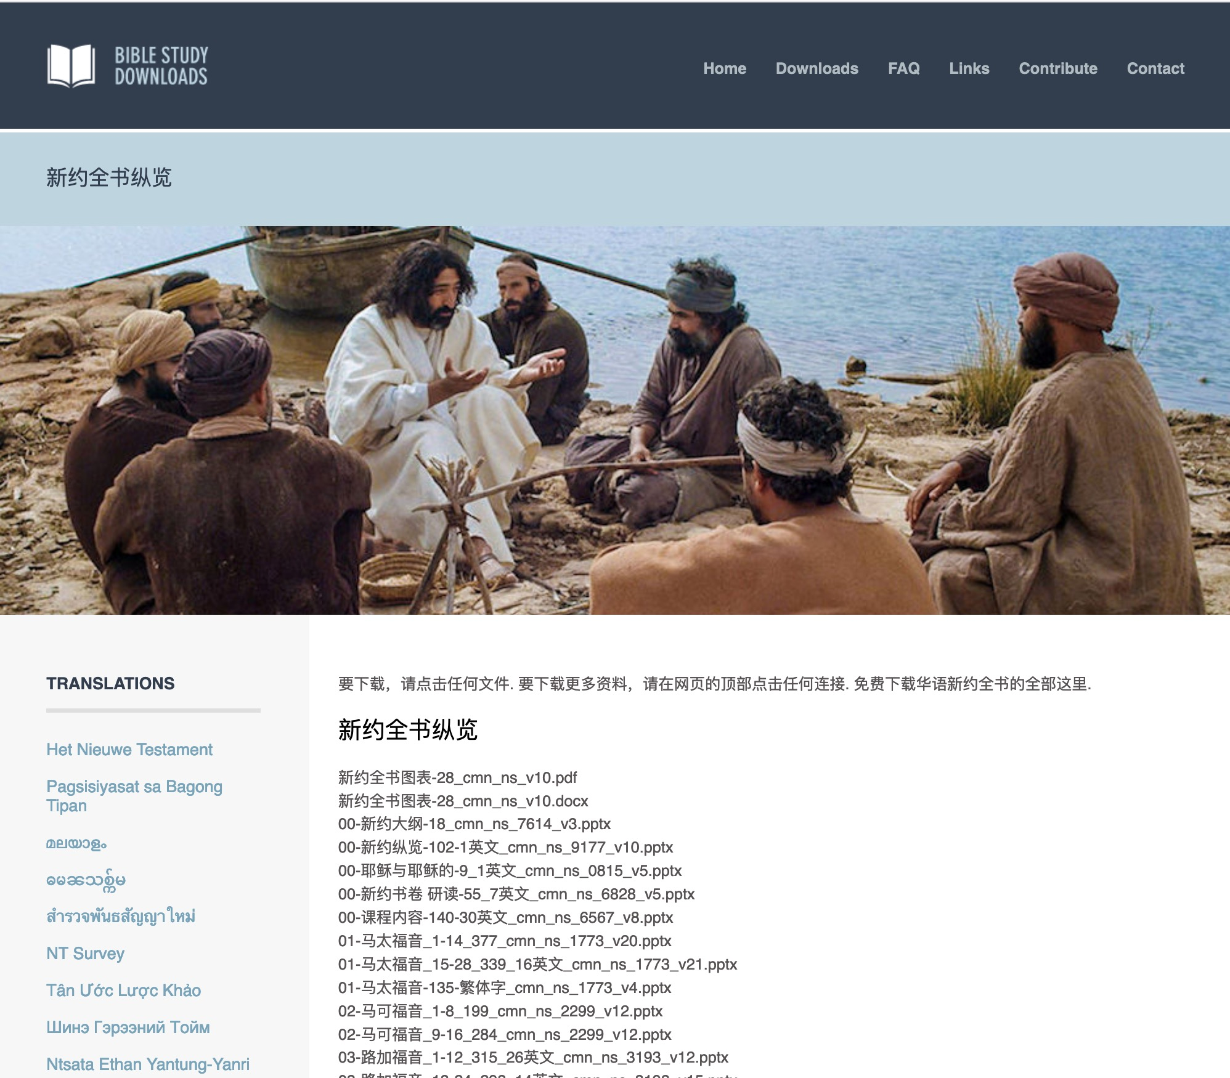
Chinese
7
01-马太福音_1-14_377_cmn_ns_1773_v20.pptx
Notes:
Chinese downloads include more than 37,000 slides as of Jan 2020. The file names are also in the various languages. This file on Matthew 1-14 means it has 377 slides in Chinese in the NT Survey course with file number 1773. The last part shows that this is version 20 of this PPT file.

Slide 38
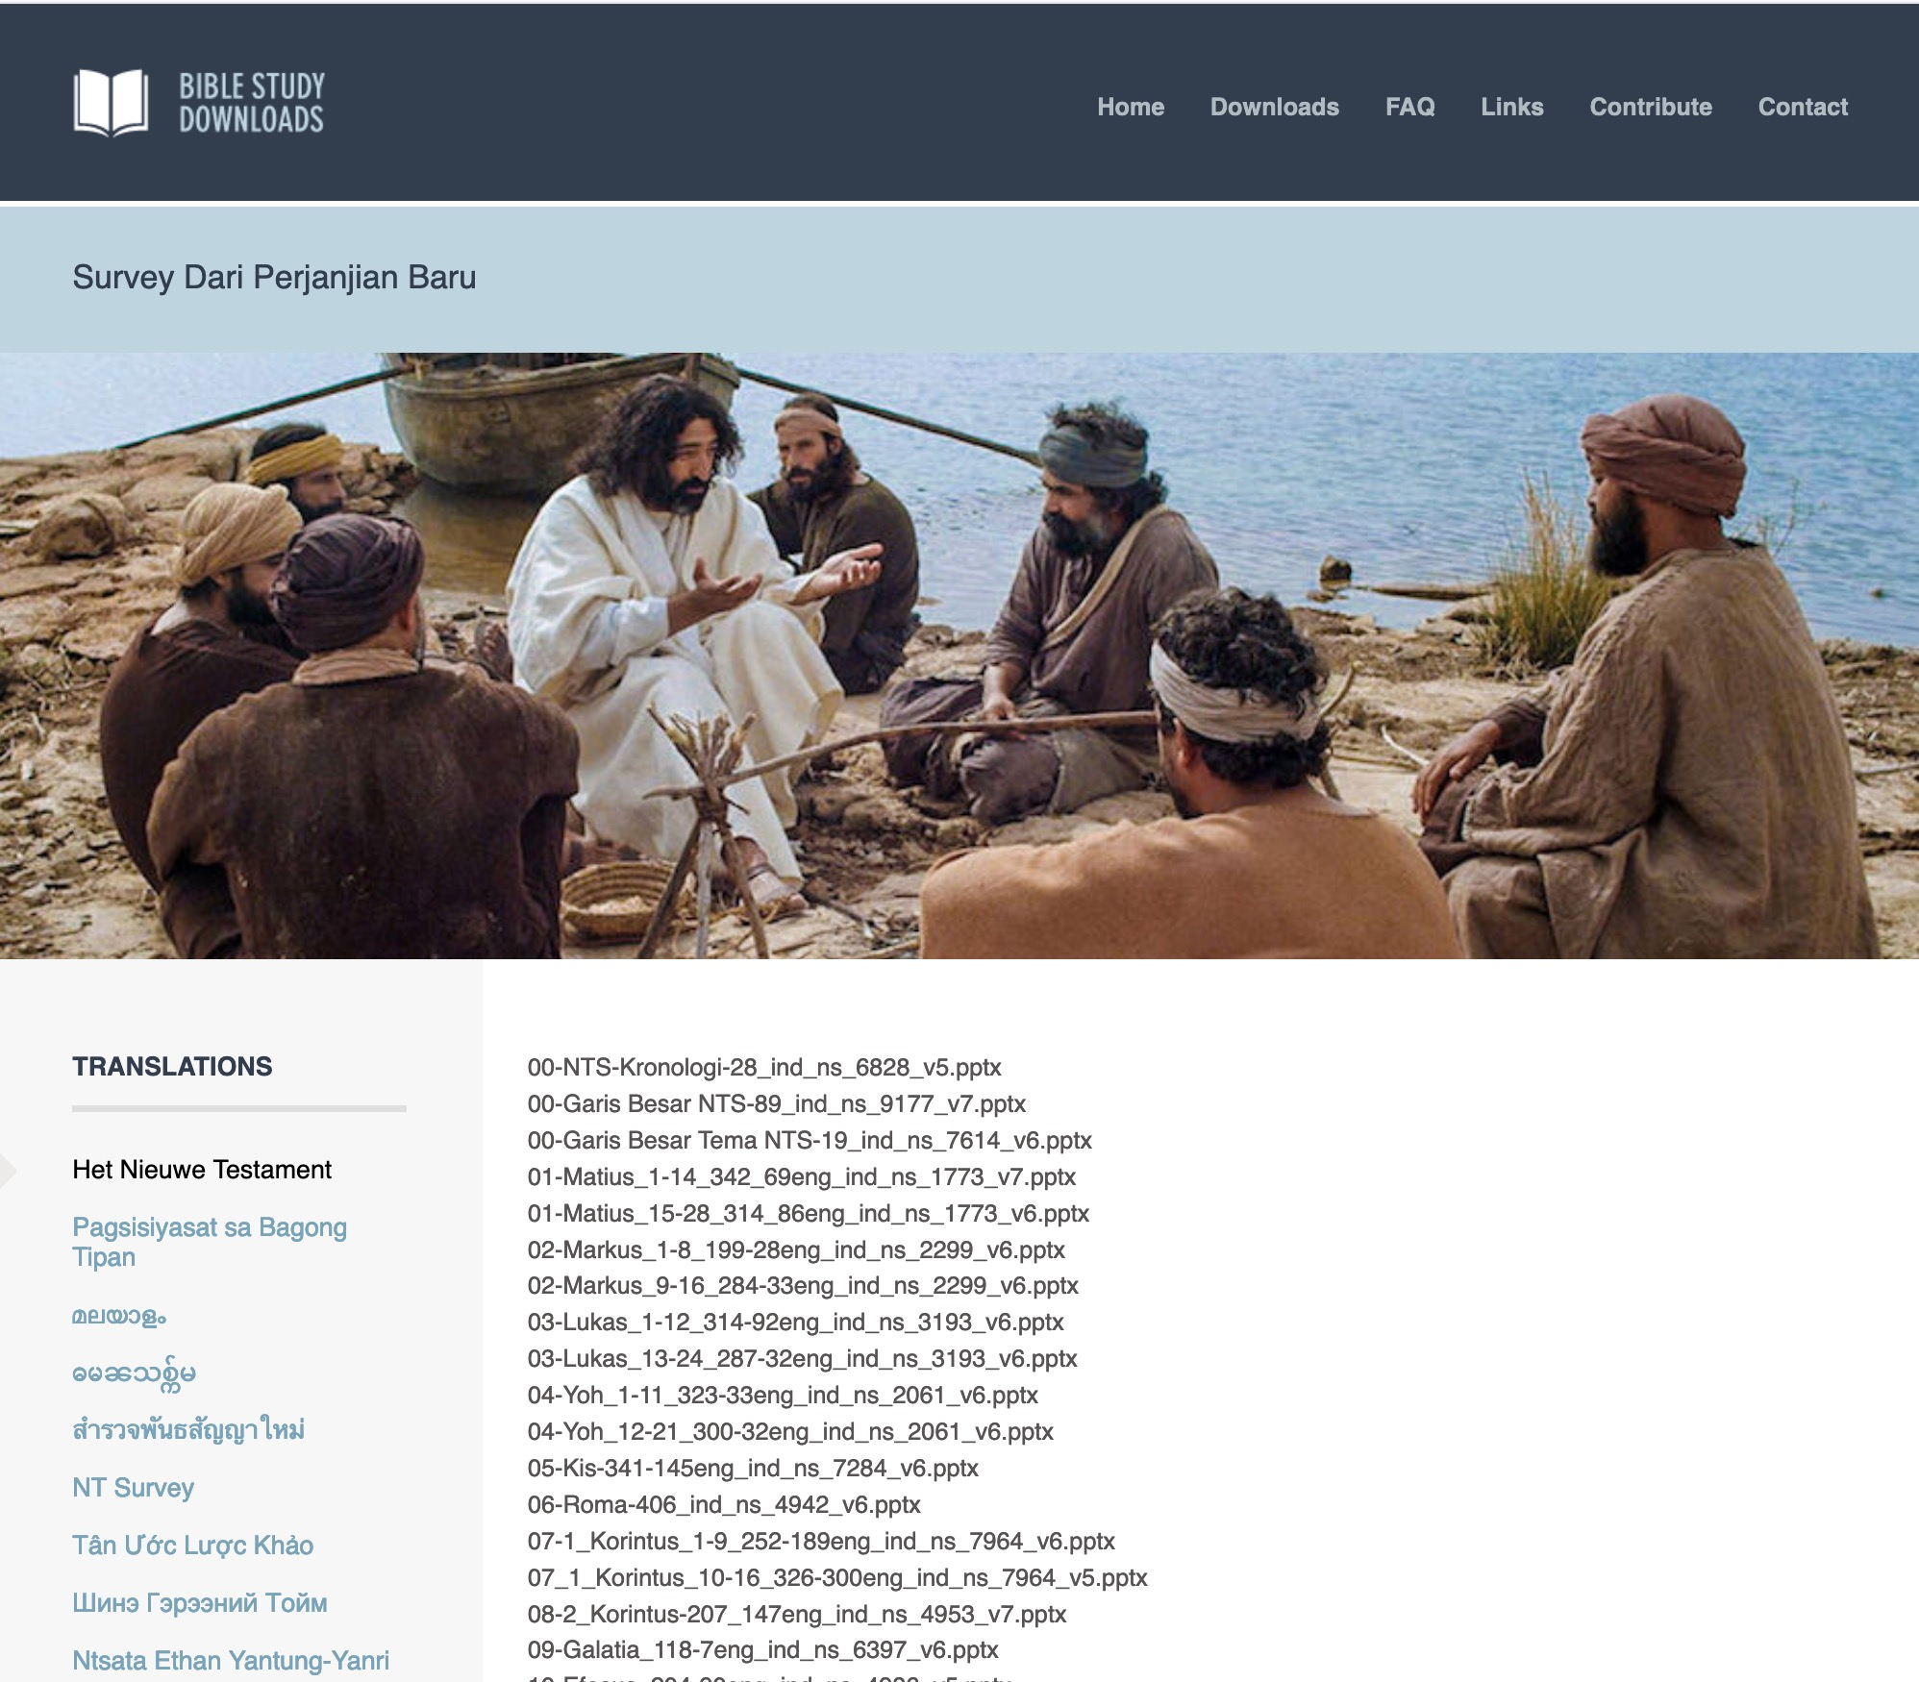
Indonesian
7
Notes:
Indonesian downloads include more than 14,000 slides as of Jan 2020.

Slide 39
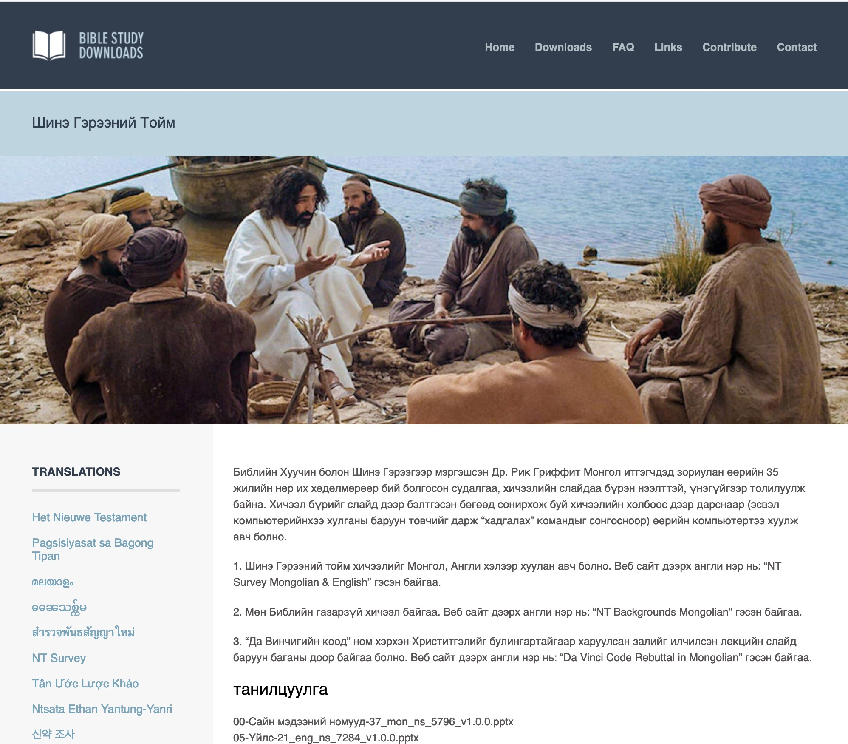
Mongolian
7
Notes:
Mongolian downloads include more than 3,000 slides as of Jan 2020.

Slide 40
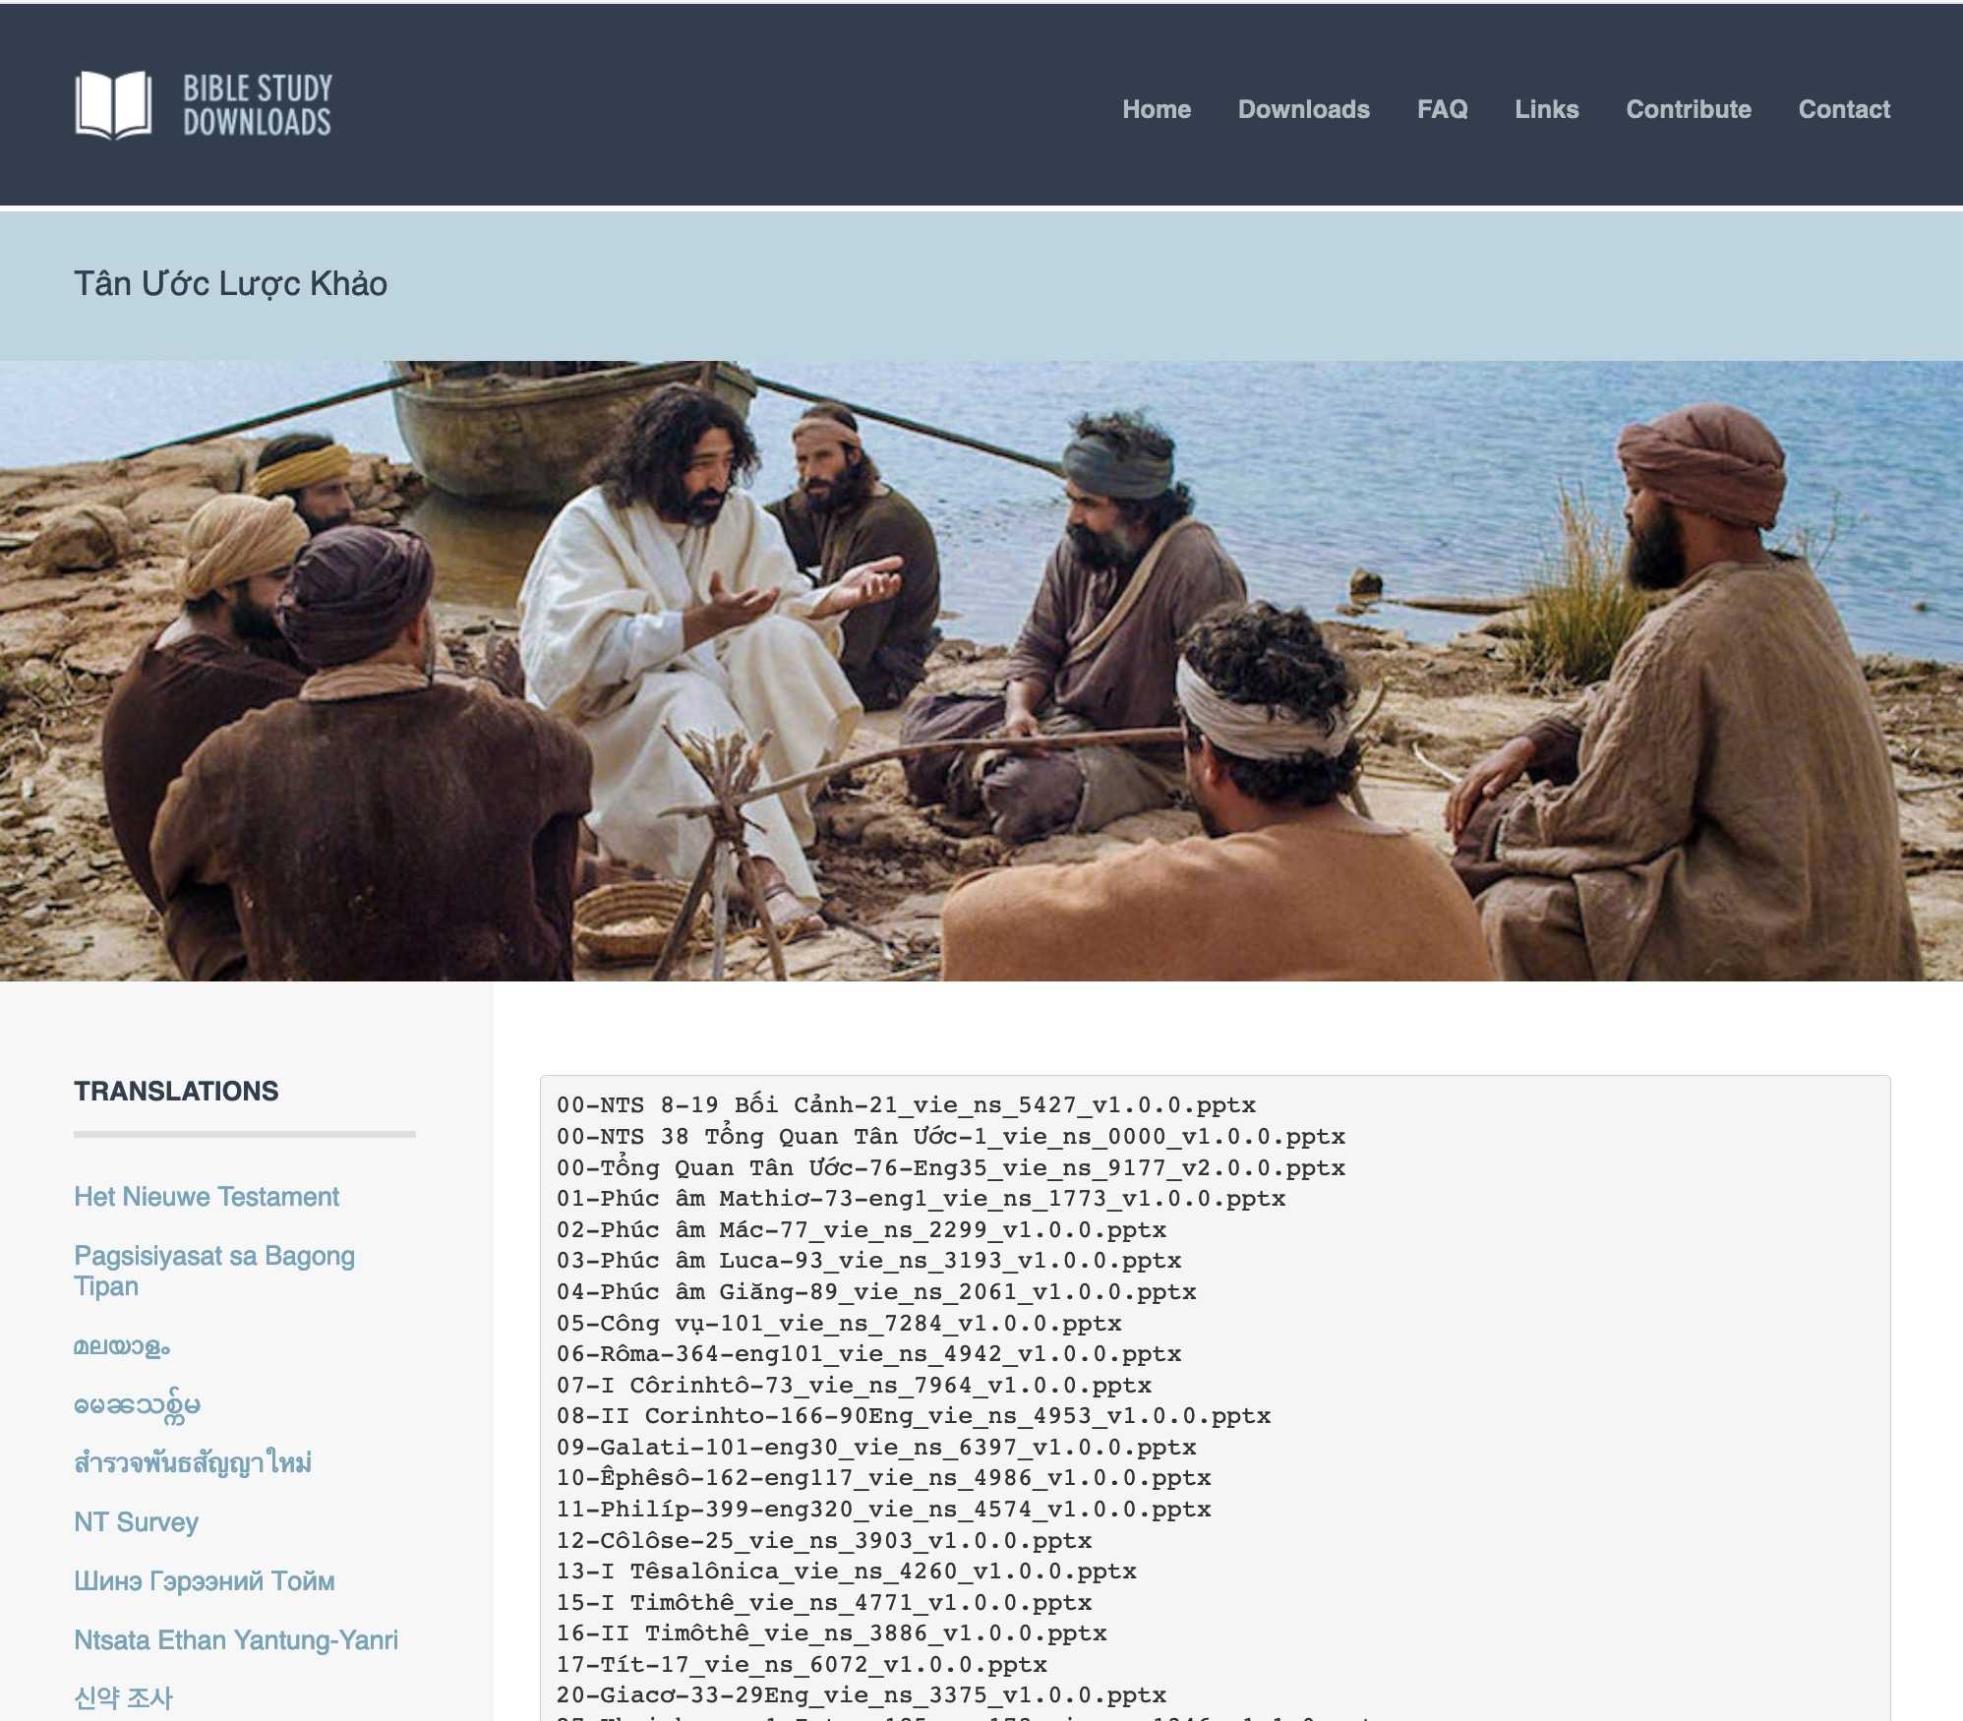
Vietnamese
7
Notes:
Vietnamese downloads include more than 8,000 slides as of Jan 2020.

Slide 41
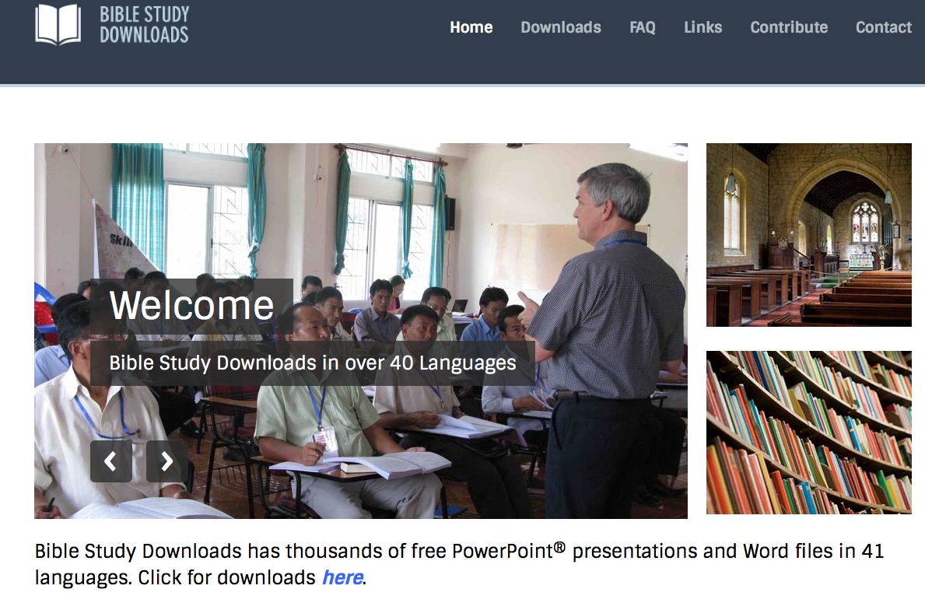
BibleStudyDownloads.org
7
Notes:
Partnering together with 700 translators has resulted in Bible teaching and study materials—mostly PowerPoint—in 49 languages! All a teacher needs to do is to click on a file and it downloads for free to teach any book of the Bible and many other subjects.

Slide 42

Christian Hospitality
Notes:
The passage is telling us too we can and should be hospitable people.
Of course, John is commending Gaius for making financial investments in missions too. He says, in effect, in verse 7, if Christians don’t support missionaries, then who will?
I once received a phone call from a wealthy doctor’s wife in our congregation in Singapore. She had a theological question for the resident missionary theologian: Should Christians use part of their tithe to support the government’s Community Chest for the needy? I told her essentially what John said here: if we Christians don’t support God’s work, then who will?

Slide 43
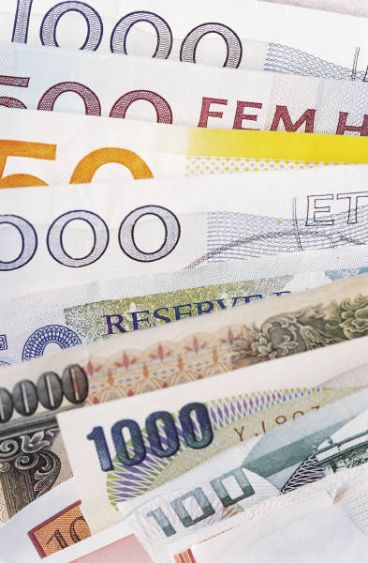
3 John – Summary Chart
305
Supporting Missionaries
1-8
9-11
12-15
Gaius
Diotrephes
Demetrius
Commended
Condemned
Recommended
Supported
Missionaries
Opposed
Missionaries
Is a
Missionary
Greetings & Prayer
1-2
Joy over Godliness
3-4
Support Confirmed
5-8
for Rejecting John
9
for Opposing
Missionaries
10
for Doing Evil
11
Good
Reputation
12
Visit
Anticipated
13-14a
Affectionate Greetings
14b-15
Asia Minor
c. AD 90
Notes:
So the first of the three ways to obey the truth is to help get the truth out is to support missionaries like Gaius.

Slide 44
How can we obey God’s truth?
306
II. Don't hinder missions like Diotrephes
(9-11)
I. Help others get the truth out like Gaius (5-8)
Notes:
Now in verses 9-10 we see a second way to obey the truth…
Avoid doing anything that will stand in the way of getting the gospel out.

Slide 45
"I wrote to the church about this, but Diotrephes, who loves to be the leader, refuses to have anything to do with us. ¹⁰When I come, I will report some of the things he is doing and the evil accusations he is making against us. Not only does he refuse to welcome the traveling teachers, he also tells others not to help them. And when they do help, he puts them out of the church"
(vv. 9-10 NLT).
Notes:
This is the opposite of supporting missions like Gaius, for Diotrephes opposed missions.

Slide 46
306
Diotrephes
"nourished by Zeus"
Gossiped about John
Refused missionaries
Threw out supporters
Notes:
It’s interesting to note that Diotrephes means "nourished by Zeus."
But what’s so unusual about a Gentile Christian with a pagan name?
Most of my SBC students are saved out of Buddhism and ancestor worship. Some are even named after Chinese deities—but after salvation they take on new names: Grace, Timothy, etc. One student from Hong Kong was named Wing Ming, but since salvation has gone by the name “Cross” to testify how Christ changed his life.
Although the common first century practice for Gentiles saved from idolatry was to change their names after embracing Christianity, Diotrephes’ pagan name was not changed after his conversion. Neither did he change his conduct.
But what did Diotrephes do that made him so bad?
• He gossiped about John and the missionaries John sent to the church. Imagine slandering the last remaining apostle who walked with Christ!
• What arrogance! Verse 10 says that he refused to welcome missionaries sent to his church.
• He even opposed missionary support to the extent of kicking people out who gave to missionaries! Can you imagine your pastor or chairman of the board excommunicating you for inviting my family over for lunch?

Slide 47

Hindrances
Hindrances
Notes:
Perhaps we don’t throw people out of this church who support missions, but…
• We can hinder the gospel through very subtle ways.
For example, sometimes we let false teaching go without a comment!

Slide 48
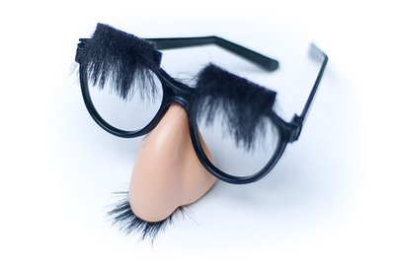
Should we name false teachers by name?
John did.
Notes:
So should we name false teachers by name? John did!

Slide 49
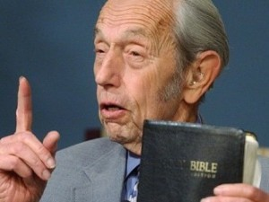
Harold Camping
"Jesus will come in 1994"
"Jesus will come 21 May 2011"
"Jesus will come 21 Oct 2011"
Notes:
When someone like Harold Camping give false prophecies about the return of Jesus, we should call it what it is.

Slide 50
Harold Camping
Camping admitted in a private interview that he no longer believed that anybody could know the time of the Rapture or the end of the world, in stark contrast to his previously staunch position on the subject. In March 2012, he stated that his attempt to predict a date was "sinful", and that his critics had been right in emphasizing the words of Matthew 24:36: "of that day and hour knoweth no man." He added that he was now searching the Bible "even more fervently...not to find dates, but to be more faithful in [his] understanding."
http://en.wikipedia.org/wiki/Harold_Camping
Notes:
Fortunately, he repented of it before he died.
http://en.wikipedia.org/wiki/Harold_Camping

Slide 51
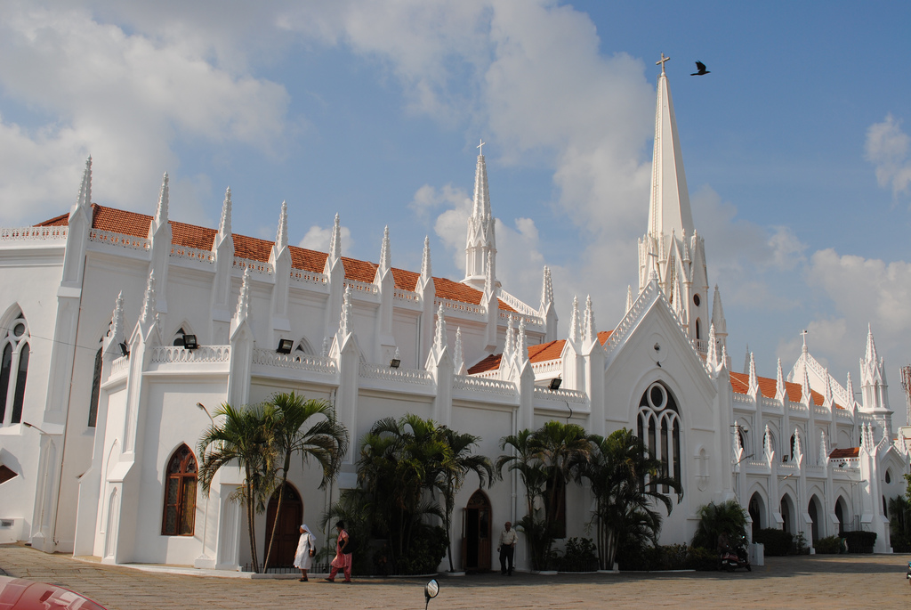
One of the oldest and strongest traditions is that in AD 52 (between Paul’s second and third missionary journeys) the apostle Thomas took the gospel to India and even China.
St Thomas Basilica, Madras, India
Notes:
Sometimes we hinder the gospel by simply telling the Lord “NO” when he calls. This is what the Apostle Thomas did initially. There is a St Thomas Basilica in Madras, India built over the tomb of the apostle Thomas. They say he was killed by an arrow or spear and then buried here in AD 72.

Slide 52
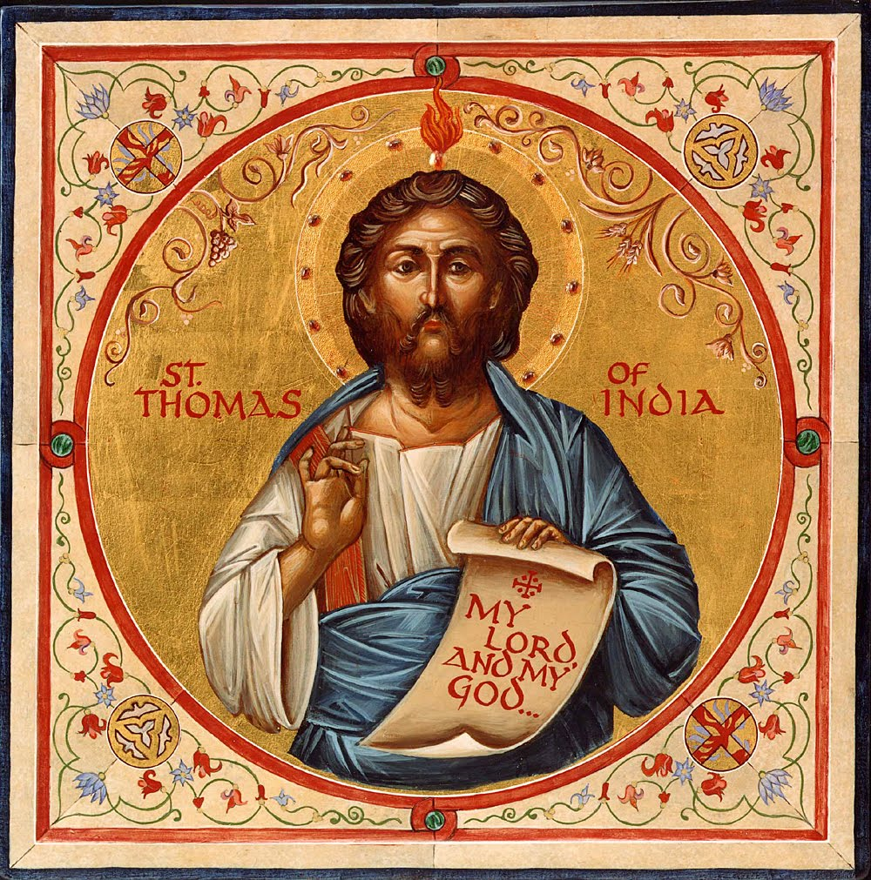
ACTS OF THOMAS
Notes:
The Acts of Thomas is an early writing that records his calling in this way. While not inspired, I think we can relate. “The Acts of Thomas was written around AD 200 by a Christian in Edessa, which was NE of Antioch. It is an apocryphal book and combines both history and legends. But it is important in the history of Christianity in Asia because except for Scripture it is the oldest record we have of the church going to Asia.
I would like to read for you the first paragraph of The Acts of Thomas. Let me remind you that this is not Scripture. But there are other writers in the early church who also say that Thomas went to India and there are many Christians in India today who call themselves Thomas Christians. So the idea and tradition that Thomas did this is very strong” (Steve Nicholes, ”Asian Church History,” PPT from Word of Life Bible Institute, Jeju, Korea).

Slide 53
“1. At that season all we the apostles were at Jerusalem … and we divided the regions of the world, that every one of us should go unto the region that fell to him and unto the nation whereunto the Lord sent him.”

Slide 54
“According to the lot, therefore, India fell unto Judas Thomas, which is also the twin: but he would not go, saying that by reason of the weakness of the flesh he could not travel, and 'I am an Hebrew man; how can I go amongst the Indians and preach the truth?’”

Slide 55
“And as he thus reasoned and spoke, the Savior appeared unto him by night and said to him: Fear not, Thomas, go thou unto India and preach the word there, for my grace is with thee.”

Slide 56
“But he would not obey, saying: Wherever you desire, send me, but somewhere else, for unto the Indians I will not go.”

Slide 57
“2 And while he thus spoke and thought, it chanced that there was there a certain merchant come from India whose name was Abbanes, sent from the King Gundaphorus.”

Slide 58
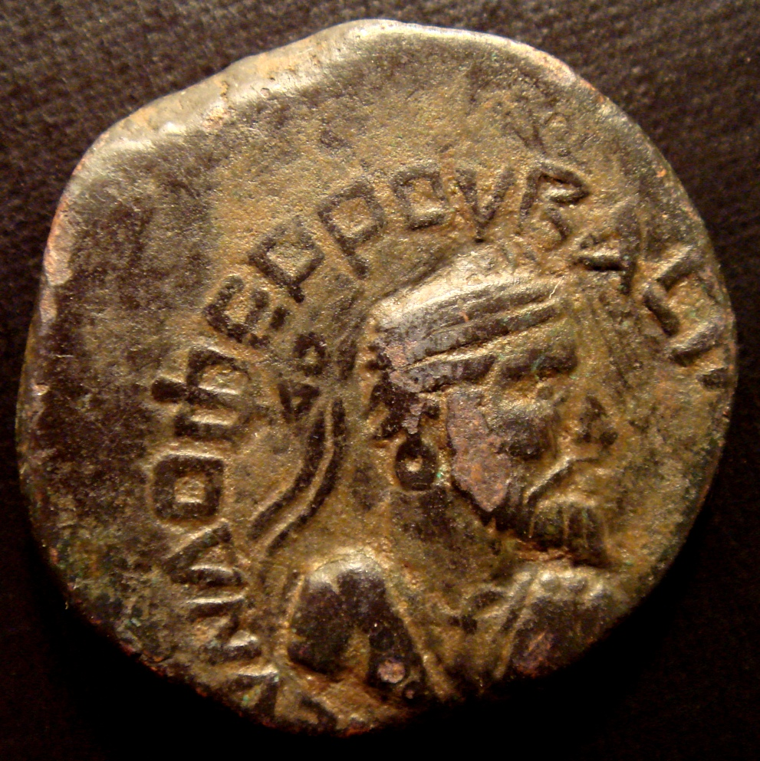
Notes:
Note that King Gundaphorus has actually been verified as a king in India at that time in a coin bearing his name.

Slide 59
“2 There a certain merchant come from India whose name was Abbanes, sent from the King Gundaphorus, and having commandment from him to buy a carpenter and bring him unto him.”

Slide 60
“Now the Lord seeing him walking in the marketplace at noon said unto him: Would you desire to buy a carpenter? And he said to him: Yea. And the Lord said to him: I have a slave that is a carpenter and I desire to sell him.”

Slide 61
“And so saying he showed him Thomas afar off, and agreed with him for three litrae of silver unstamped, and wrote a deed of sale, saying:”

Slide 62
“I, Jesus, the son of Joseph the carpenter, acknowledge that I have sold my slave, Judas by name, unto you Abbanes, a merchant of Gundaphorus, king of the Indians.”

Slide 63
“And when the deed was finished, the Savior took Judas Thomas and led him away to Abbanes the merchant, and when Abbanes saw him he said unto him: Is this your master? And the apostle said: Yes, he is my Lord.”

Slide 64
“And he said: I have bought you from him. And the apostle held his peace.”

Slide 65
“3. And on the day following the apostle arose early, and having prayed and besought the Lord he said: I will go wherever You desire, Lord Jesus: Your will be done. And he departed unto Abbanes the merchant, taking with him nothing at all except only his price.”

Slide 66
“For the Lord had given it to him, saying: Let your price also be with you, together with my grace, wherever you go. And the apostle found Abbanes carrying his bags on board the ship; so he also began to carry it aboard with him.”

Slide 67
“And when they were on the ship and were set down Abbanes questioned the apostle, saying: What craftsmanship do you know? And he said: In wood I can make ploughs and yokes and augers (ox-goads, Syr.), and boats and oars for boats and masts and pulleys; and in stone;”

Slide 68
“pillars & temples & court-houses for kings. And Abbanes the merchant said to him: Yes, that is the kind of workman we need. They began then to sail homeward; and they had a favorable wind, and sailed prosperously till they reached Andrapolis (Gk. also called Sandaruk), a royal city. ”

Slide 69
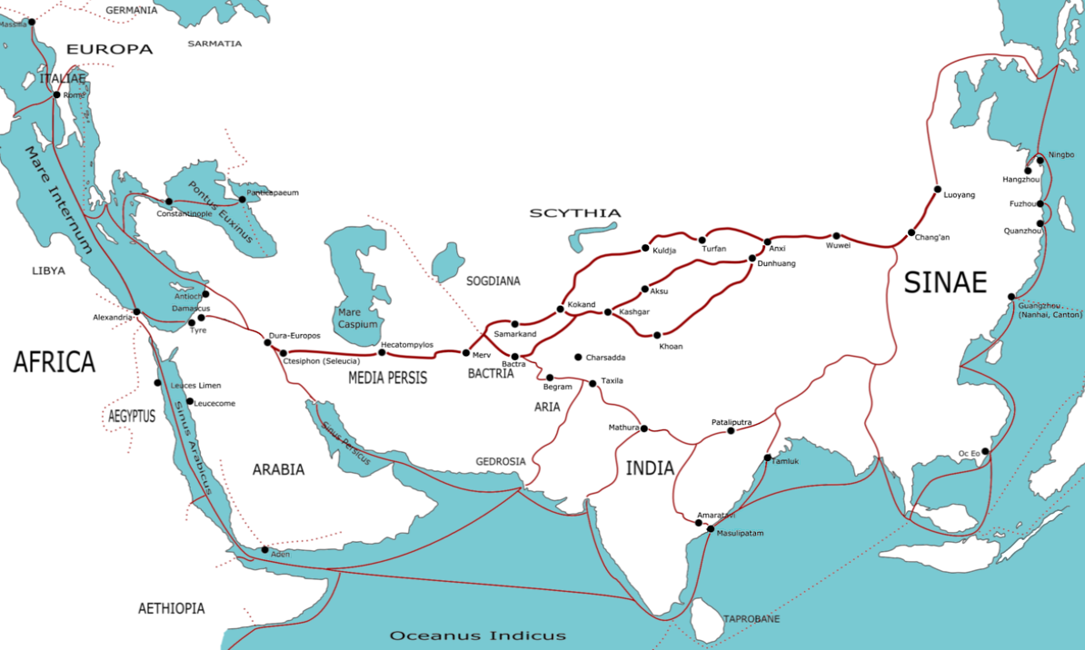
Transasia trade routes (First Century AD)
In the first century one ship was going from Egypt to India every three days

Slide 70
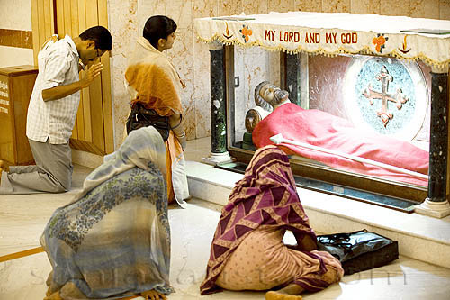
Notes:
The memory of Thomas continues in Madras where his life is commemorated.

Slide 71
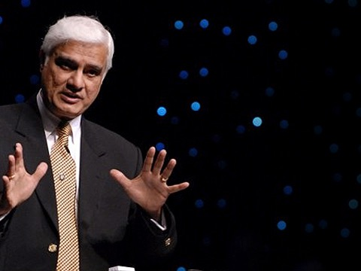
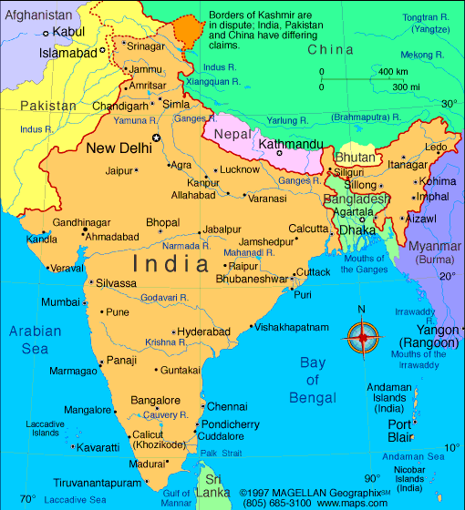
Notes:
We are also indebted to many Indians such as Ravi Zacharias…

Slide 72
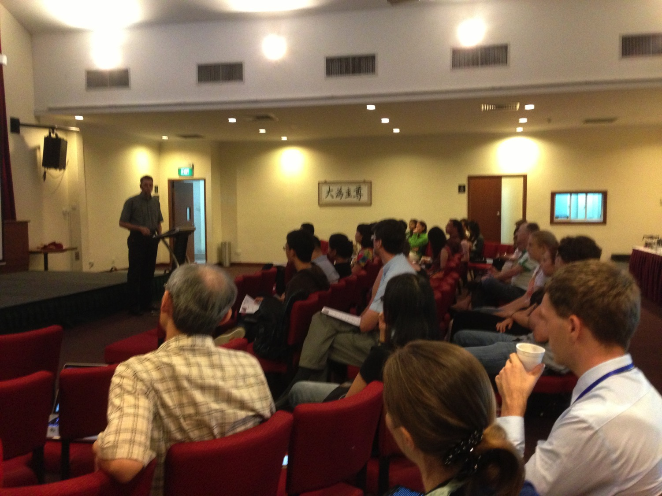

Our People
9
61 people from 13 nations
February 2020
Notes:
…and our own Andrew Spurgeon here at this church, who is one of our key speakers.

Slide 73


Crossroads People • Feb 2020
UK
CHINA
JAPAN
UNITED KINGDOM
RUSSIA
FRANCE
NETHERLANDS
MONGOLIA
ITALY
KOREA
HONG KONG
LEBANON
JAPAN
CHINA
TAIWAN
GERMANY
MYANMAR
CANADA
EGYPT
INDIA
USA
THAILAND
ETHIOPIA
MALAYSIA
ZIMBABWE
KENYA
PHILIPPINES
SINGAPORE
INDONESIA
SOUTH AFRICA
CIC
AUSTRALIA
NEW ZEALAND
Notes:
We actually have about 20% Indian at CIC, thanks to St. Thomas, who overcame his initial reluctance to witness for Jesus in India.
Our Feb 2020 church of 51 people stem from 11 different countries around the world: Australia (Gilli-Anne, David & Fiona), China (Jianji), Korea (Grace Kim), India (Cynthia), Indonesia (Rena, Andrie), Kenya (Judy), Myanmar (Peng), Netherlands (Toes), New Zealand (Ashleigh), Singapore (Albina), Thailand (Mae), UK (James & Gabi), USA (Miriam).
This does not include people who have recently attended only once:
Nor does it include missionaries living back in their countries but still are members of CIC: Maple (Taiwan), Budmaa (Mongolia)
Previous: Canada (Gloria Lee), Ethiopia (Lele), Malaysia (Aston, Naomi), Netherlands (Dies & Desiree), Philippines (Micah), South Africa (Melody),

Slide 74

Our People
Preaching through Scripture
Notes:
Susan and I helped start Crossroads International Church in 2006 and I serve as the pastor-teacher because God wants to get his truth out through this church.

Slide 75
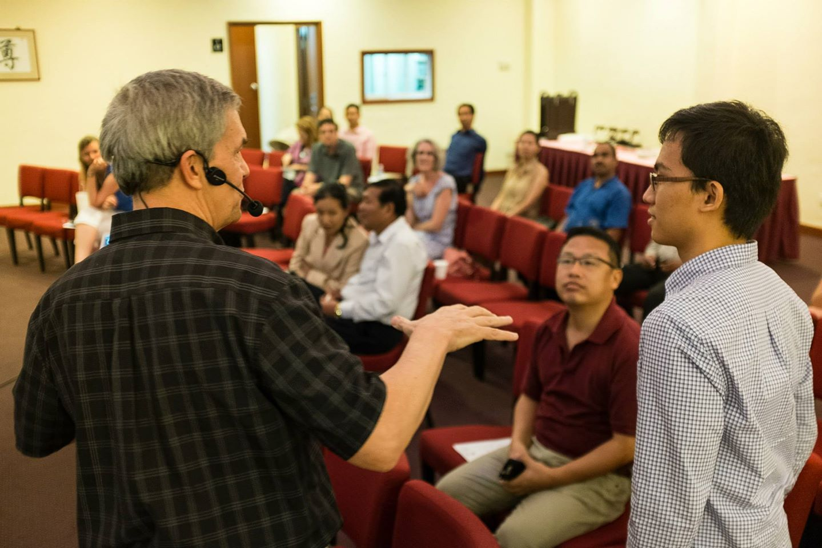
Our People
9
61 people from 13 nations
Notes:
Part of our ministry is to invest in young leaders like Demetrius in 3 John 12.

Slide 76

Our People
9
SBC students serve at church
Notes:
Ober the years, one special joy is mentoring my students who serve with us at church and led ministries to youth, children, home groups, and the worship team.

Slide 77
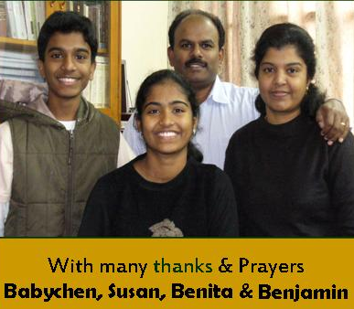
Missions Giving
20%
Notes:
“We have to take care of our own needs here first!” is a temptation for some churches. That’s why when we planted Crossroads International Church in Singapore, from the start we committed to invest in other countries 20% of our offerings!

Slide 78
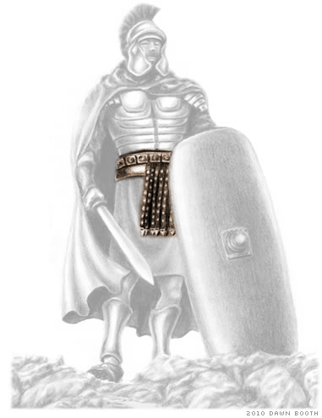
"Dear friend, don't let this bad example influence you. Follow only what is good. Remember that those who do good prove that they are God's children, and those who do evil prove that they do not know God" (v. 11 NLT).
Notes:
There are so many clever ways that Satan has devised to keep the church from its primary mandate. Let’s be wary of them, as verse 11 warns…

Slide 79
How can we obey God’s truth?
306
III. Become a mission-ary like Demetrius
(12)
II. Don't hinder missions like Diotrephes
(9-11)
I. Help others get the truth out like Gaius (5-8)
Notes:
So how can we obey God’s truth?
• We’re to be people who propagate the truth. How? Support missionaries like Gaius
• and don’t hinder the gospel like Diotrephes. But it would be amiss not to share the final way to obey the truth, and that is to…
• Spread God’s truth by being a witness yourself in the footsteps of Demetrius.

Slide 80
306
Demetrius
¹²Everyone speaks highly of Demetrius, as does the truth itself. We ourselves can say the same for him, and you know we speak the truth.
Notes:
Demetrius was almost assuredly the missionary who carried the letter from John to Gaius.
He had a good reputation so he was sent out—a guy whom the whole church would vouch for. And even if the truth could speak, it would agree: “Here’s a quality guy!”
Notice John didn’t say, “Hey, Gaius, we still have needs over here in Ephesus. Sorry we can’t send any quality people your way, but you know how it is, the home church needs them.”

Slide 81



Multiply Yourself into Trustworthy Men!
"You have heard me teach things that have been confirmed by many reliable witnesses. Now teach these truths to other trustworthy people who will be able to pass them on to others" (2 Tim. 2:2 NLT).
Discipleship
Paul
Timothy
Reliable Men
Others
Notes:
What’s it saying to us?
Let’s send our best people overseas.
When the church at Antioch was praying in Acts 13, the Holy Spirit told the church to send out Paul and Barnabas as missionaries. If you could read between the lines, the church said, “What?! Paul and Barnabas? Wait, they are our two key pastors! We can’t send them out!”

Slide 82

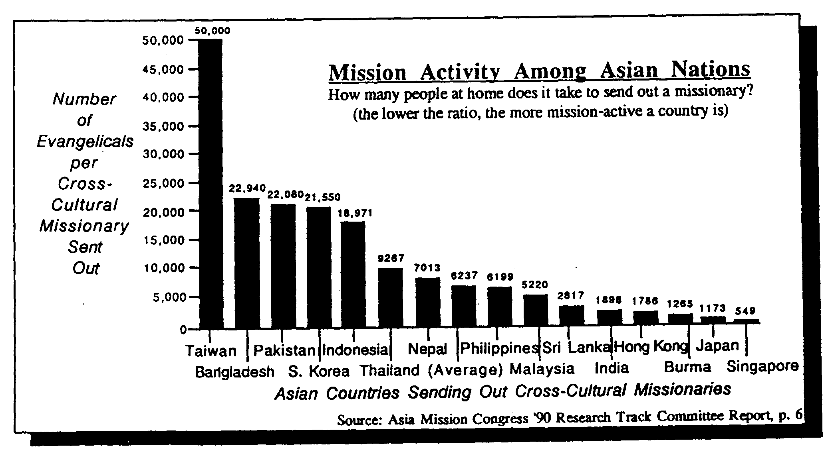
Missions in Singapore 1990
= 549 Believers per Missionary
309
Notes:
One of my ministries is to be encouraging the Asian countries to be involved in missions. Among the best of them is Singapore, which in 1990 took only 549 believers to send out one missionary. The lesser, the better!

Slide 83
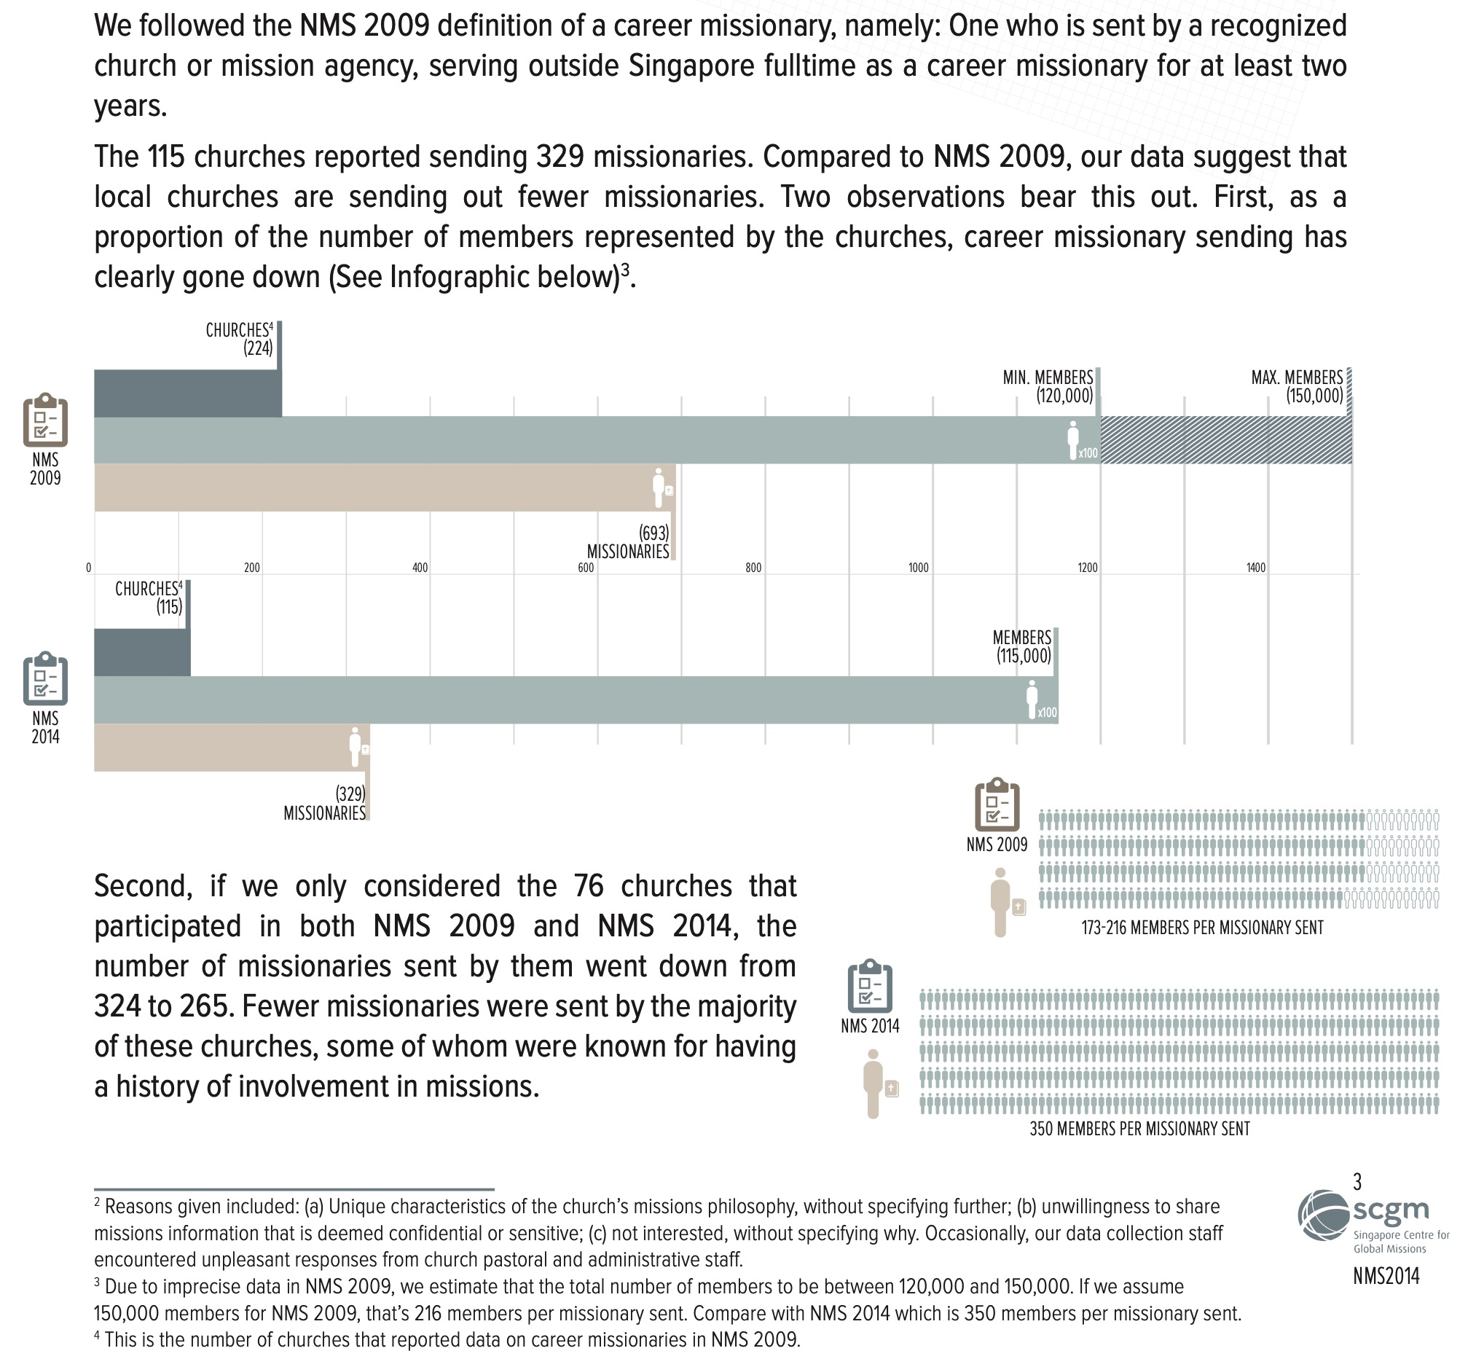
Missions in Singapore 2009
= 200 Believers per Missionary
309
Missions in Singapore 2014
= 350 Believers per Missionary
Notes:
Singapore improved in its missions commitment from 1990 to 2009, where the 549 believers to send out one missionary reduced to 200 Christians. However, five years later it crept up to 350 believers needed to send out one missionary. We need this to go back down!

Slide 84
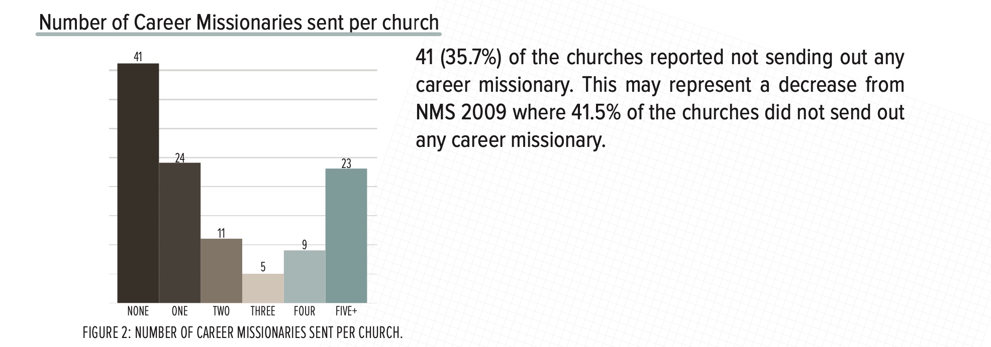
About one third of churches haven’t sent out even one career missionary
309
Our church is one of the 9 that has sent out four missionaries.
Notes:
We need to heed the teaching of 3 John!

Slide 85
Our Church's Vision
Love the Nations
Love the Church
Love God
Notes:
Our vision is threefold love of God, the church, and the nations—so we should be like one of our supporting churches that keeps losing its pastoral staff to overseas missions. What a great way to have to replace your pastors! Sure they leave gaps at home. But this provides opportunities to develop even more leaders for the kingdom!

Slide 86


Crossroads in Missions
Notes:
Missions has always been a priority here—perhaps partly due to all three of your elders being missionaries!

Slide 87

Missions Giving
24%
20%
Notes:
We commit to give one fifth of offerings to ministry outside Singapore. Last year we hit 24%. This includes missionaries such as these…

Slide 88
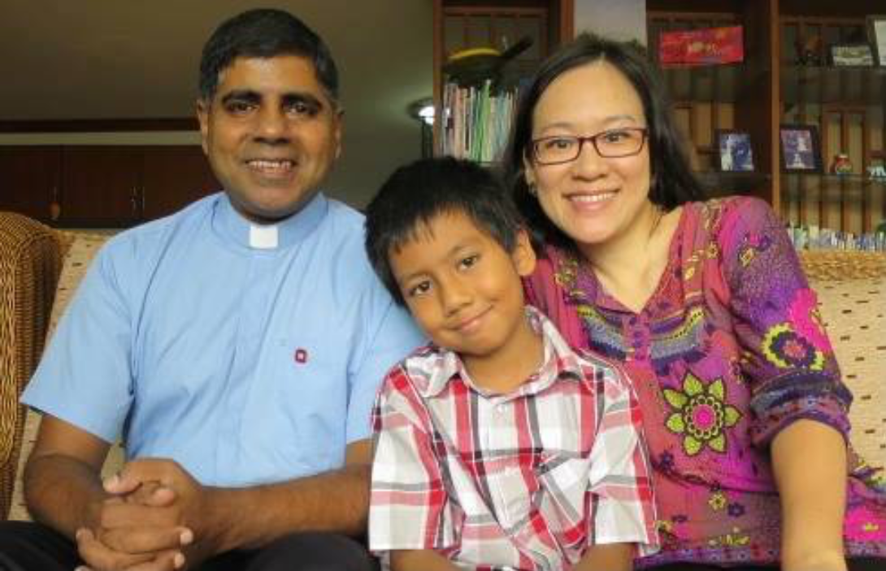
The Coreas in Bangkok
$1500 quarterly through March
Notes:
They will return to Singapore next month, so our support will be reallocated outside Singapore.

Slide 89
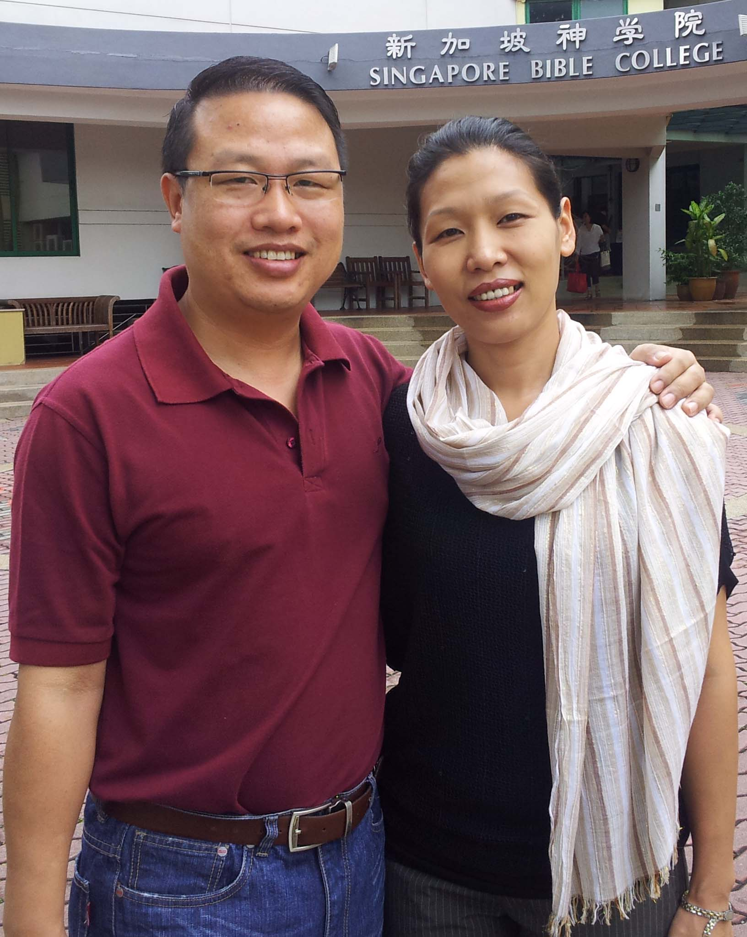
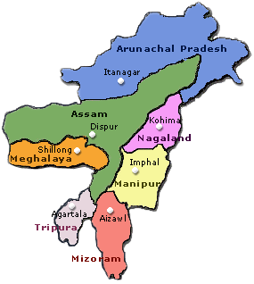
Athan & Chanchan in India/USA
$1500 quarterly through 2020
Notes:
Likewise, Athan and Chanchan have an evangelistic ministry to reach the poor in Manipur, India. We commit to support nationals for their training until they return home, when we feel their own people should support them. Athan will get his doctorate in Dec 2020 so our support will continue only until then.

Slide 90
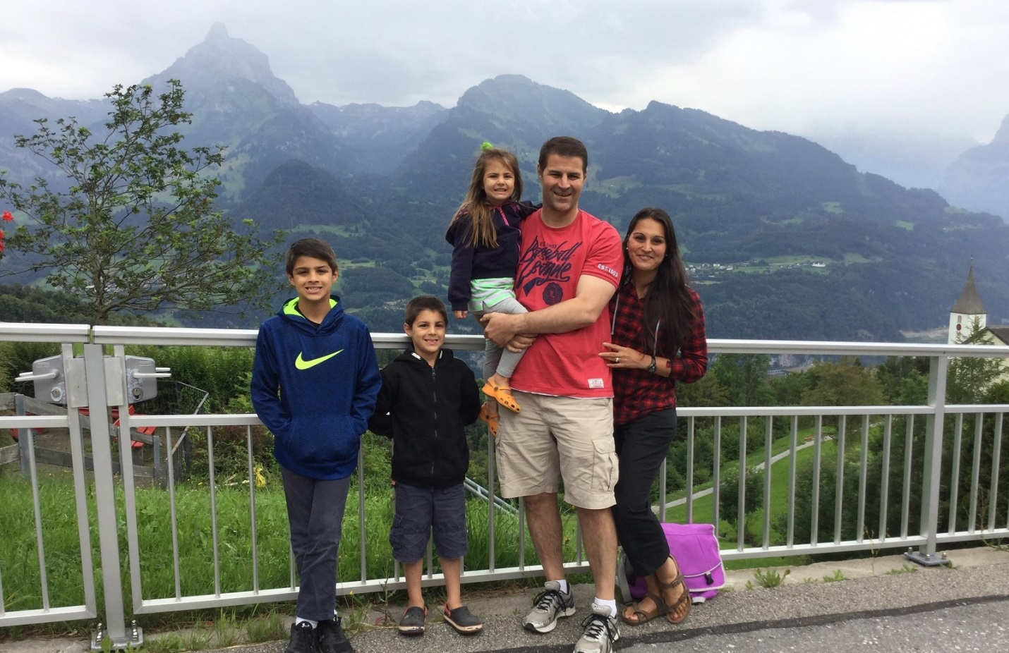
Family in Central Asia
$1200 annually
Notes:
Some minister in high security zones, so we do not reveal their names of locations.

Slide 91
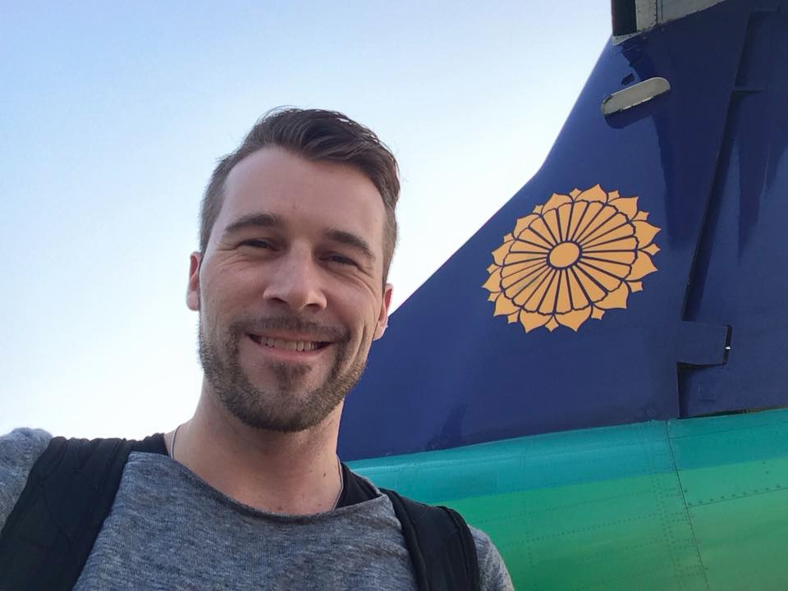
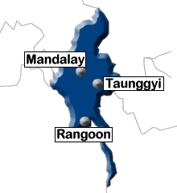
Myanmar 2014?
Jonathan Stone in Myanmar
$900 quarterly
Notes:
Jonathan disciples leaders who reach kids for Jesus.

Slide 92
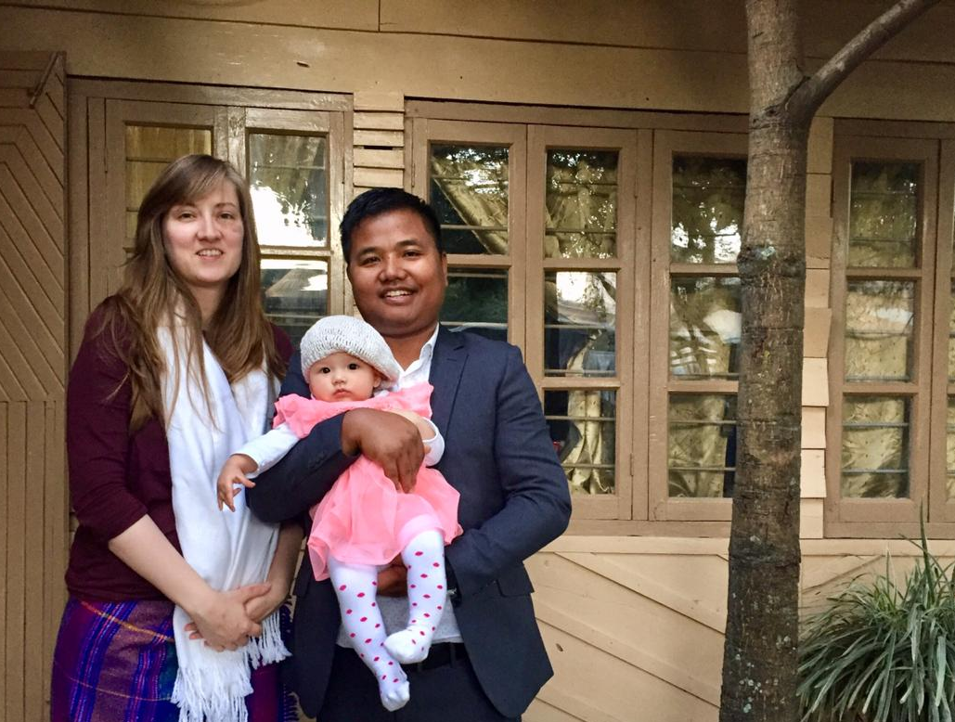
Sarah, Noah & Kezia Chiru
Former Young Adult Coordinator(s)
Notes:
92
92
It’s exciting to see how God continues to send out His best. Our member Noah is one of the few trained Chiru believers in the world, but served right among our church until he and Sarah returned to NE India in 2018.

Slide 93
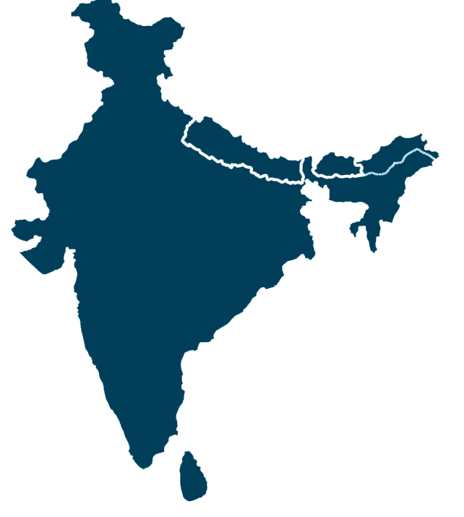
Noah (Chiru Tribe, Manipur)
Notes:
Noah is from the North-East part of India.

Slide 94
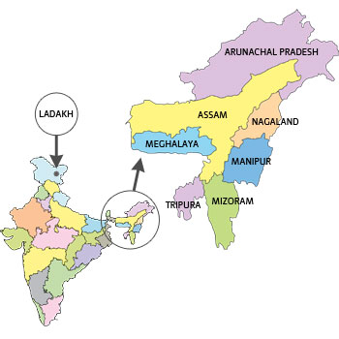
Noah (Chiru Tribe, Manipur)
Notes:
His tribe has only 6000 people who speak Chiru and, though they have had the gospel for 80 years now, they still need the OT translation finished. Good thing Noah married a Wycliffe translator! Like Gaius supporting Demetrius, so we are partnering with Noah and Sarah to get the truth out.

Slide 95
Balance relationships with tasks (13-15).
"I have much more to say to you, but I don't want to write it with pen and ink. ¹⁴For I hope to see you soon, and then we will talk face to face. ¹⁵Peace be with you. Your friends here send you their greetings. Please give my personal greetings to each of our friends there"
(vv. 13-15 NLT).
Notes:
John ends with the desire for face-to-face ministry and an exchange of greetings.

Slide 96
How can we obey God's truth?
Notes:
OK, so what’s the message of John’s third epistle? How can we obey God’s truth? Simply this…

Slide 97

Live out God's truth by supporting missions in the way God has for you.
MAIN IDEA OF 3 JOHN
Notes:
The Lord has a specific place in his vineyard for you to share his truth—find it and go for it!

Slide 98

Summary Statement
307
John encourages Gaius to continue supporting missionaries such as Demetrius despite opposition from Diotrephes to help the church to see its responsibility to finance God's work.
Notes:
God’s truth is being attacked on numerous fronts: Buddhism, Islam, New Age Movement, Relativism, and a host of others. But He wants to use both you and me as His instruments in proclaiming the truth.

Slide 99
How can we obey God’s truth?
306
III. Become a mission-ary like Demetrius
(12)
II. Don't hinder missions like Diotrephes
(9-11)
I. Help others get the truth out like Gaius (5-8)
Notes:
Would you bow your heads right now as we consider what He would have us each do? With whom do you identify?
• Are you a Gaius? One whom God has called to minister to the world by staying but with a global concern? One whose main role is financial support? hospitality? Go for it!
• Perhaps you have been a Diotrephes—one with “mission myopia,” who has tried to put the brakes on missionary zeal of others—perhaps even your own children who are interested in missions? Repent of it!
• Or do you best relate to Demetrius? One in whose heart God has worked and confirmed through the saints that you are to be sent out? You go for it too!

Slide 100

What About You?
305
How are you advancing the gospel by supporting missionaries through hospitality and finances?
Notes:
The beautiful thing in all this is that neither Gaius nor Demetrius’ job is more important. As John says in verse 8, God has called both “so that we may work together for the truth.”

Slide 102
NT Preaching link at BibleStudyDownloads.org
Get this presentation and script for free!
Notes:
NT Preaching (np)

